Slide 1
Simple Load Pull Report
None

Slide 2
Test Configuration
Frequencies: (GHz)
8.9, 9.4, 9.9, 10.4, 10.9, 11.4, 11.9
Input Powers: (dBm)
14, 16, 18, 22
Load Impedances:
Gamma Magnitude:
0.1, 0.2, 0.3, 0.4, 0.5
Gamma Phase
-175, -165, -155, -145, -135, -125, -115, -105, -95, -85, -75, -65, -55, -45, -35, -25, -15, -5, 5, 15, 25, 35, 45, 55, 65, 75, 85, 95, 105, 115, 125, 135, 145, 155, 165, 175
Comments
None
Data and Time: 2025-08-11_10_30

Slide 3
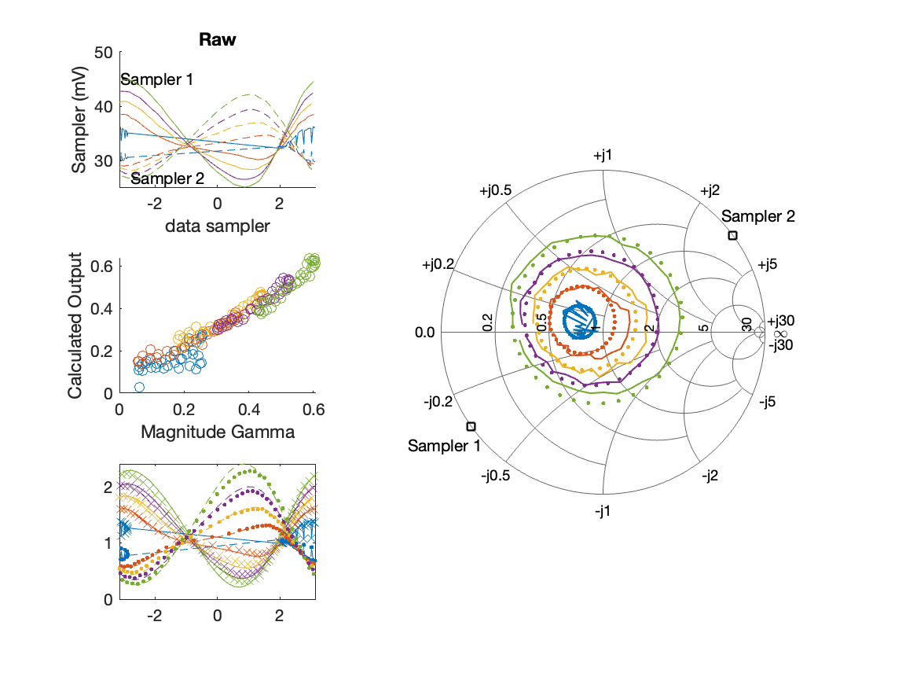
Sampler Performance Frequency 10.40 GHz, Power 14 dBm
Sampler Av
Sampler 1: 48.142
Sampler 2: 64.290
Sampler Offset (rather than -1)
-3.6309
Goodness Of fit
0.08258

Slide 4
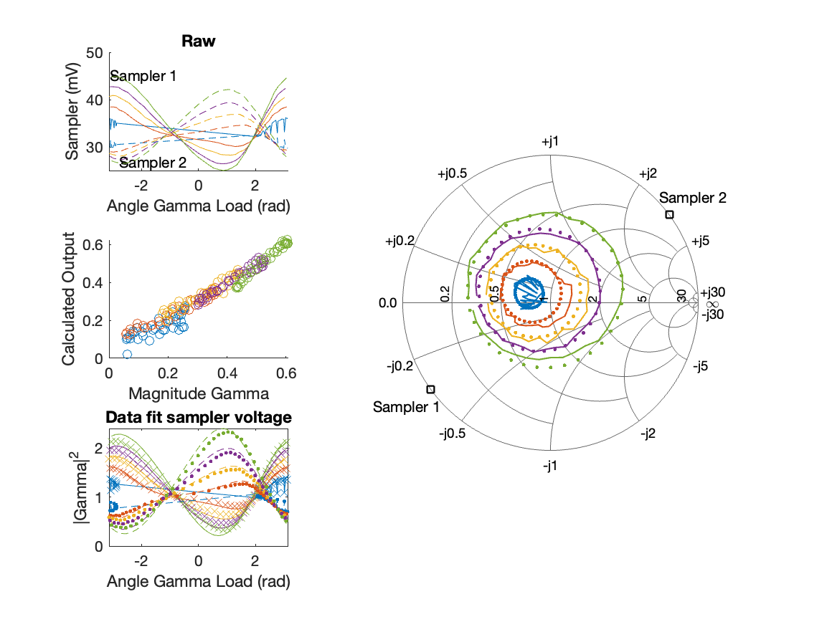
Sampler Performance x^3 Frequency 10.40 GHz, Power 14 dBm
Sampler Av
Sampler 1: 4.995183e+01
Sampler 2: 29.027
Sampler Av3
Sampler 1: -10.485
Sampler 2: 21.042
Sampler Offset (rather than -1)
-2.8285
Goodness Of fit
0.056858

Slide 5
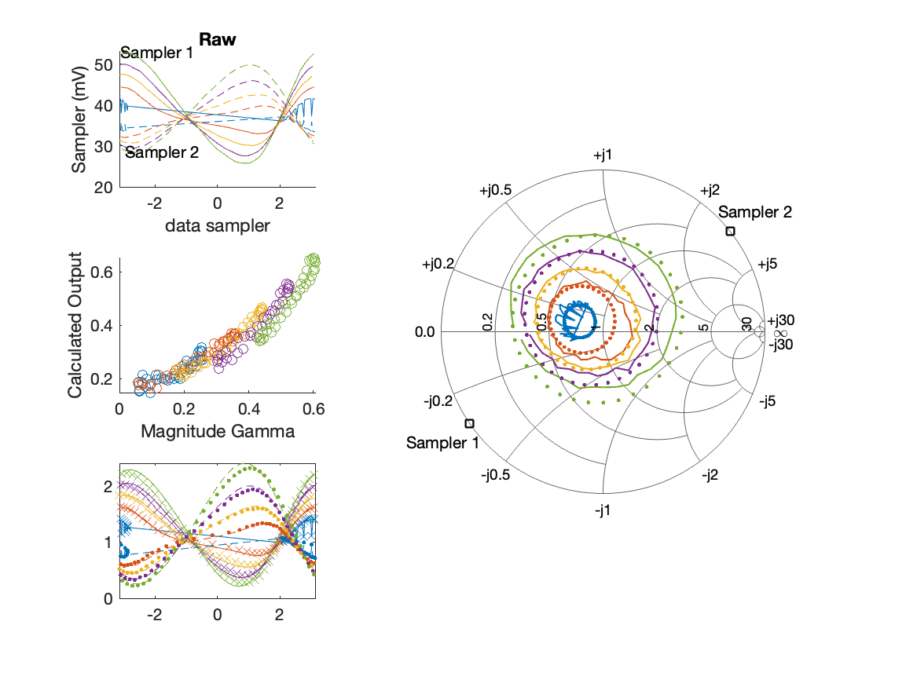
Sampler Performance Frequency 10.40 GHz, Power 16 dBm
Sampler Av
Sampler 1: 35.834
Sampler 2: 48.670
Sampler Offset (rather than -1)
-3.0615
Goodness Of fit
0.15539

Slide 6
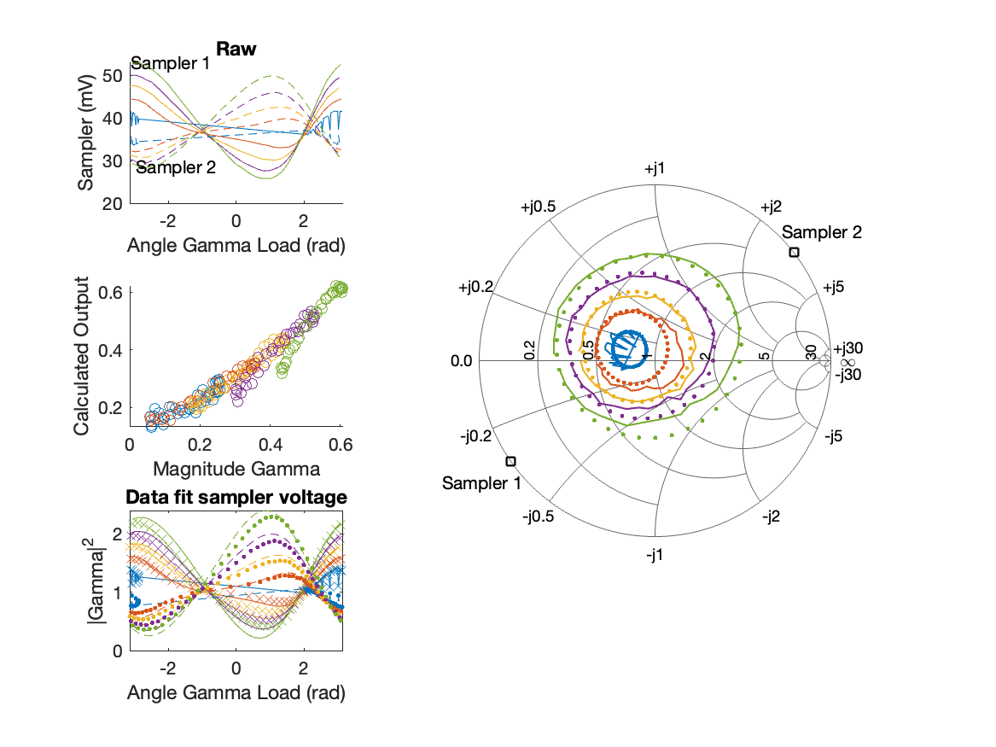
Sampler Performance x^3 Frequency 10.40 GHz, Power 16 dBm
Sampler Av
Sampler 1: 2.563111e+01
Sampler 2: 27.201
Sampler Av3
Sampler 1: 11.336
Sampler 2: 15.552
Sampler Offset (rather than -1)
-2.1644
Goodness Of fit
0.093627

Slide 7

Sampler Performance Frequency 10.40 GHz, Power 18 dBm
Sampler Av
Sampler 1: 21.660
Sampler 2: 29.768
Sampler Offset (rather than -1)
-2.1708
Goodness Of fit
0.26754

Slide 8
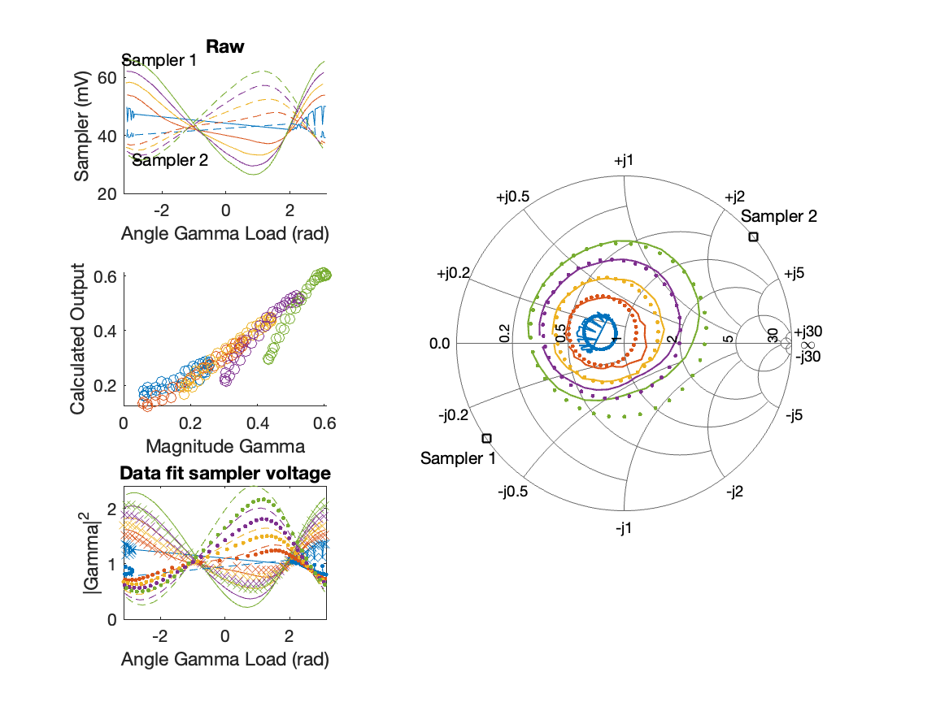
Sampler Performance x^3 Frequency 10.40 GHz, Power 18 dBm
Sampler Av
Sampler 1: 1.359926e+01
Sampler 2: 11.859
Sampler Av3
Sampler 1: 9.425
Sampler 2: 13.059
Sampler Offset (rather than -1)
-1.3096
Goodness Of fit
0.13436

Slide 9
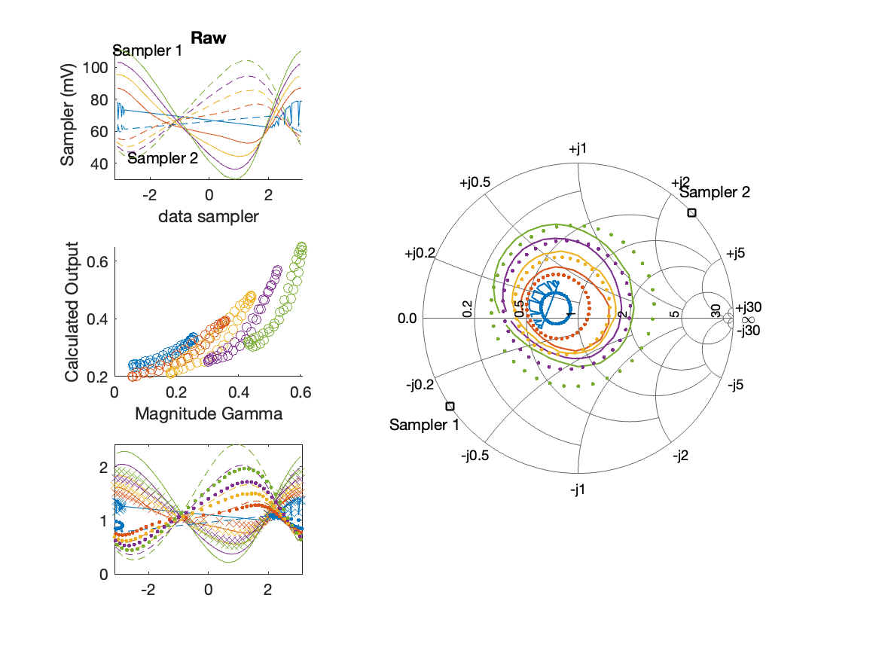
Sampler Performance Frequency 10.40 GHz, Power 22 dBm
Sampler Av
Sampler 1: 8.718
Sampler 2: 12.529
Sampler Offset (rather than -1)
-1.3472
Goodness Of fit
0.46813

Slide 10
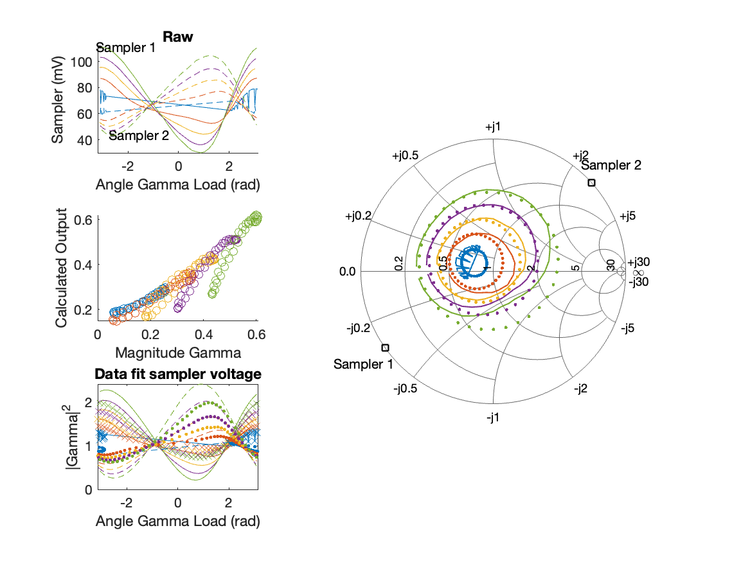
Sampler Performance x^3 Frequency 10.40 GHz, Power 22 dBm
Sampler Av
Sampler 1: 3.345292e+00
Sampler 2: 4.431
Sampler Av3
Sampler 1: 6.437
Sampler 2: 7.304
Sampler Offset (rather than -1)
-0.66861
Goodness Of fit
0.18317

Slide 11
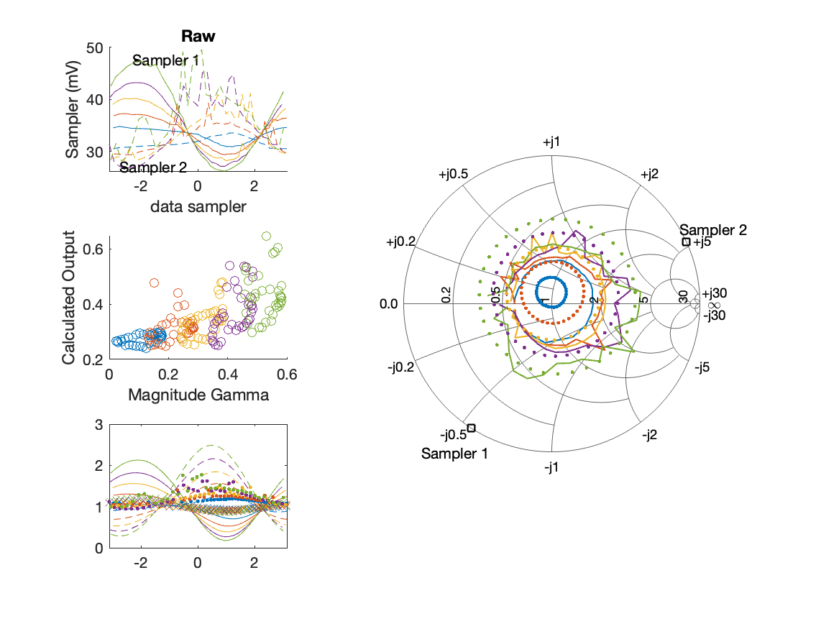
Sampler Performance Frequency 10.90 GHz, Power 14 dBm
Sampler Av
Sampler 1: 8.302
Sampler 2: 18.228
Sampler Offset (rather than -1)
-0.78005
Goodness Of fit
1.036

Slide 12
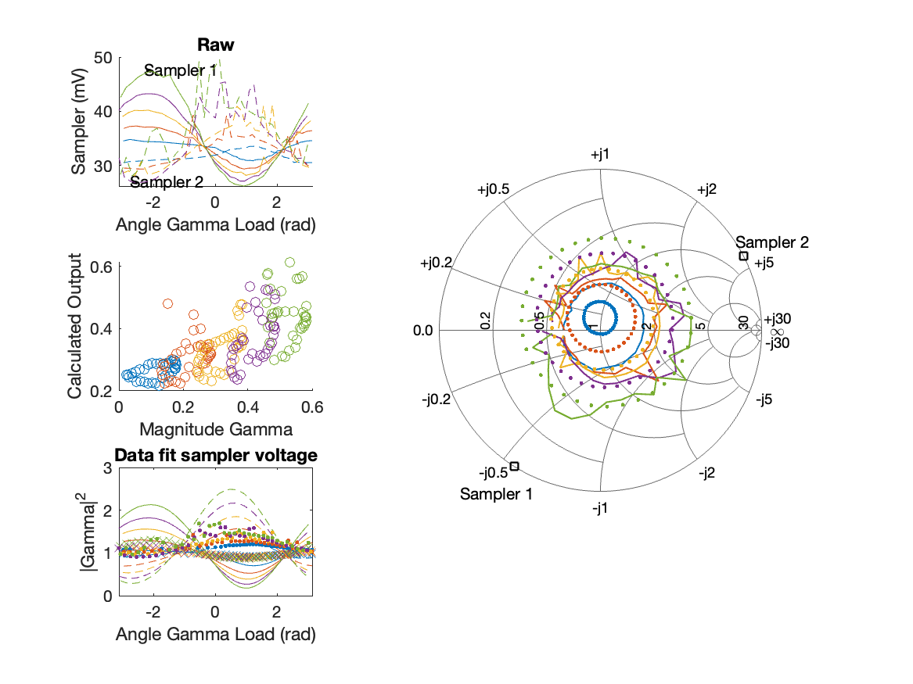
Sampler Performance x^3 Frequency 10.90 GHz, Power 14 dBm
Sampler Av
Sampler 1: 2.160730e-09
Sampler 2: 29.370
Sampler Av3
Sampler 1: 13.484
Sampler 2: -13.873
Sampler Offset (rather than -1)
-0.86898
Goodness Of fit
0.96512

Slide 13
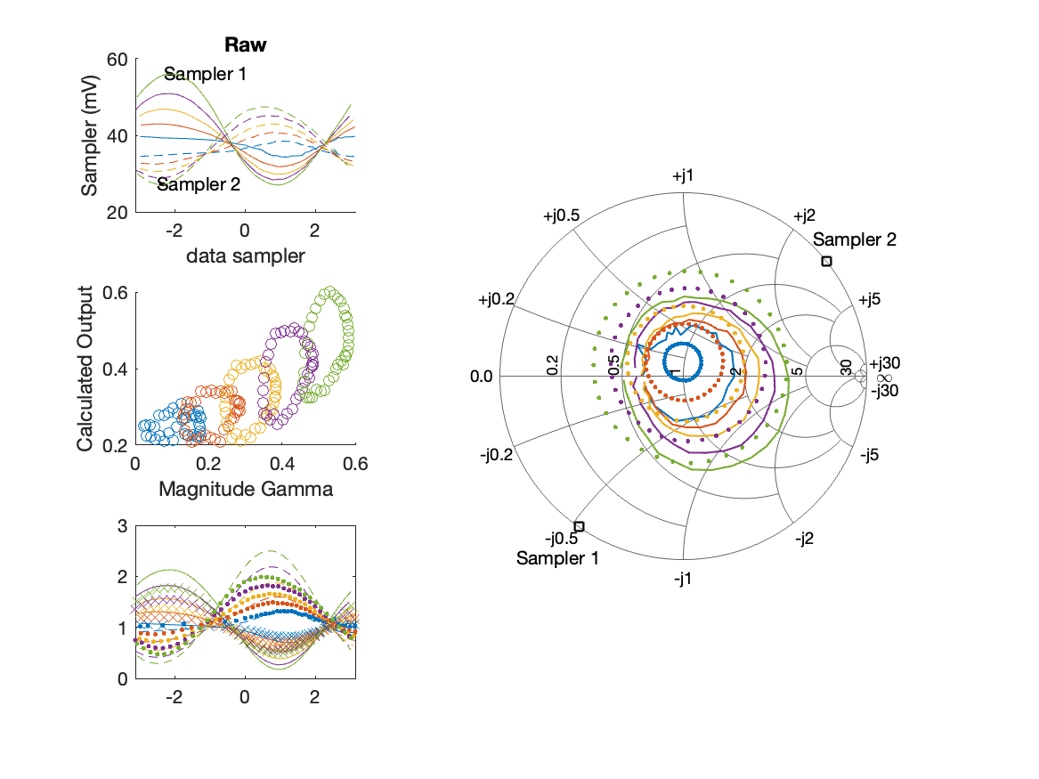
Sampler Performance Frequency 10.90 GHz, Power 16 dBm
Sampler Av
Sampler 1: 22.068
Sampler 2: 37.396
Sampler Offset (rather than -1)
-2.1186
Goodness Of fit
0.78544

Slide 14
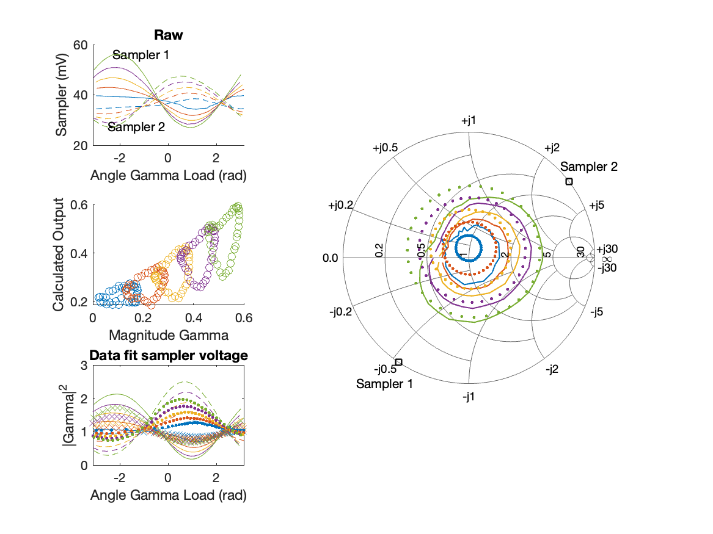
Sampler Performance x^3 Frequency 10.90 GHz, Power 16 dBm
Sampler Av
Sampler 1: 5.269389e+00
Sampler 2: 0.000
Sampler Av3
Sampler 1: 13.262
Sampler 2: 19.204
Sampler Offset (rather than -1)
-0.60894
Goodness Of fit
0.57523

Slide 15
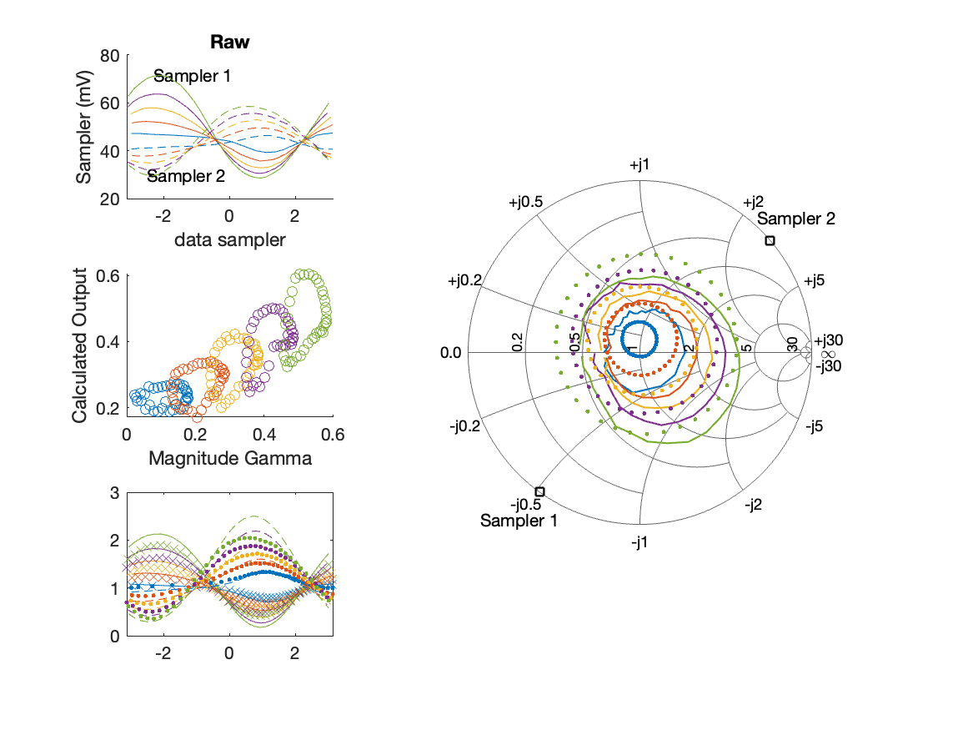
Sampler Performance Frequency 10.90 GHz, Power 18 dBm
Sampler Av
Sampler 1: 17.147
Sampler 2: 29.195
Sampler Offset (rather than -1)
-1.9582
Goodness Of fit
0.67278

Slide 16
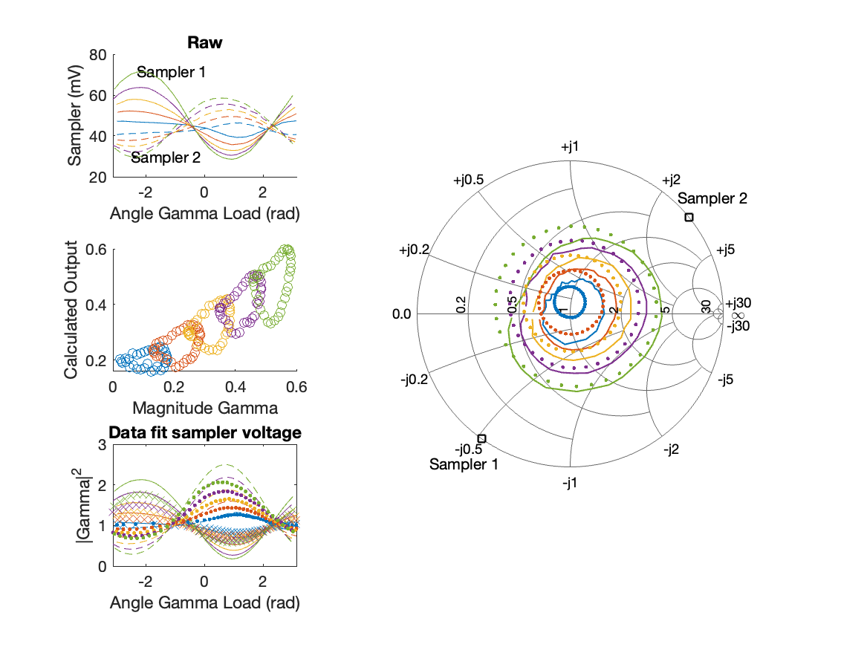
Sampler Performance x^3 Frequency 10.90 GHz, Power 18 dBm
Sampler Av
Sampler 1: 9.975550e+00
Sampler 2: 0.000
Sampler Av3
Sampler 1: 7.861
Sampler 2: 15.822
Sampler Offset (rather than -1)
-0.75865
Goodness Of fit
0.45345

Slide 17
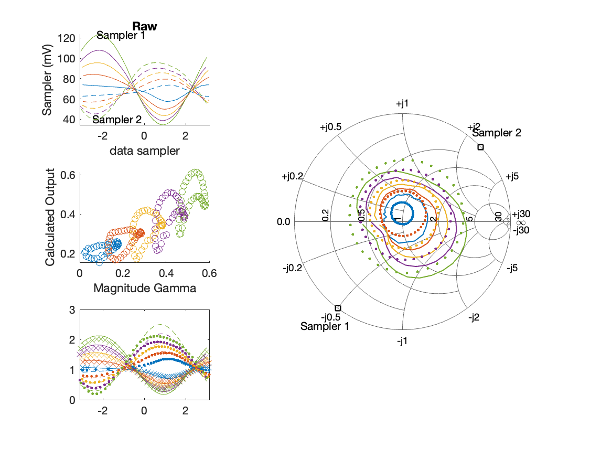
Sampler Performance Frequency 10.90 GHz, Power 22 dBm
Sampler Av
Sampler 1: 9.593
Sampler 2: 17.143
Sampler Offset (rather than -1)
-1.7527
Goodness Of fit
0.58564

Slide 18
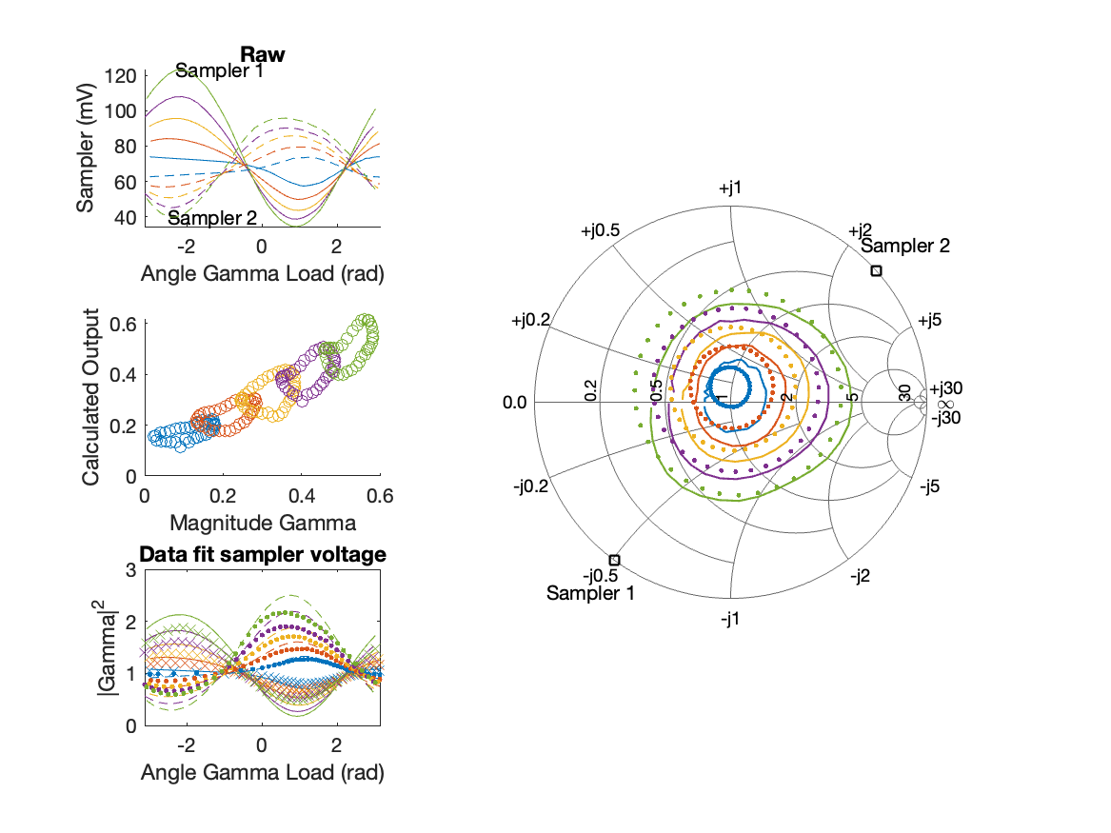
Sampler Performance x^3 Frequency 10.90 GHz, Power 22 dBm
Sampler Av
Sampler 1: 6.674241e+00
Sampler 2: 1.381
Sampler Av3
Sampler 1: 3.842
Sampler 2: 9.540
Sampler Offset (rather than -1)
-0.79795
Goodness Of fit
0.29412

Slide 19
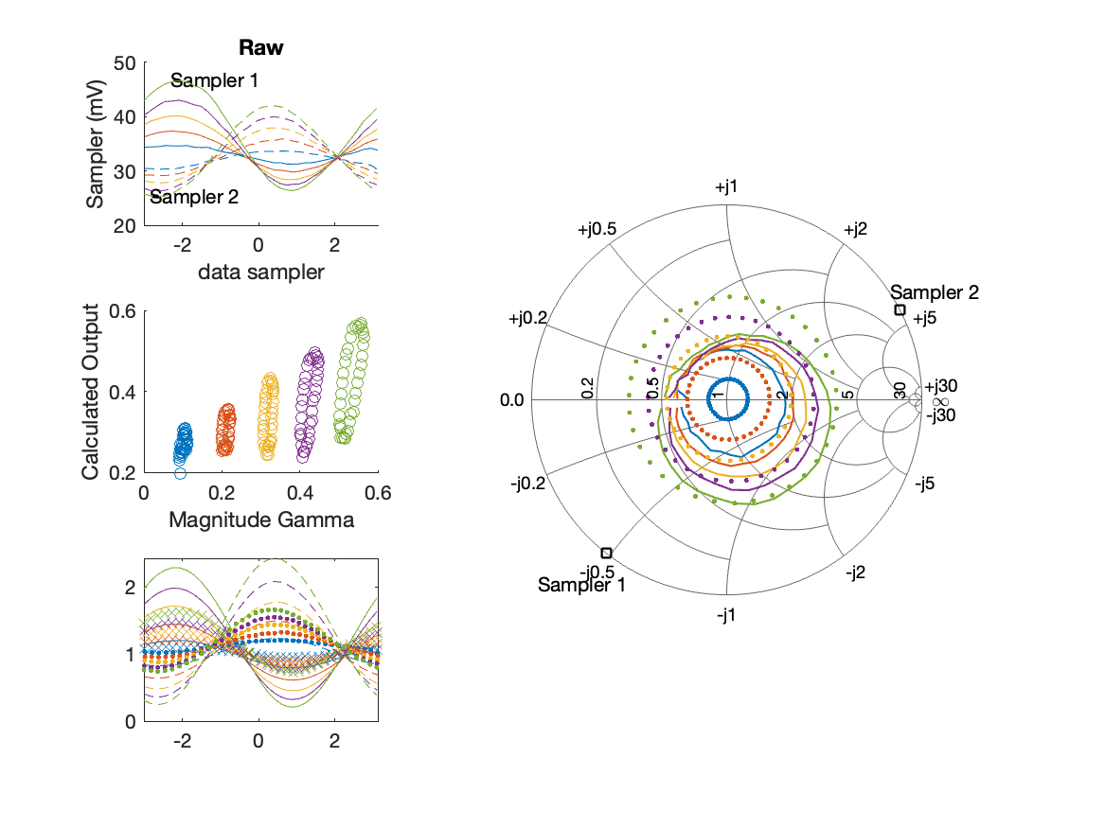
Sampler Performance Frequency 11.40 GHz, Power 14 dBm
Sampler Av
Sampler 1: 22.184
Sampler 2: 27.362
Sampler Offset (rather than -1)
-1.5405
Goodness Of fit
0.95969

Slide 20
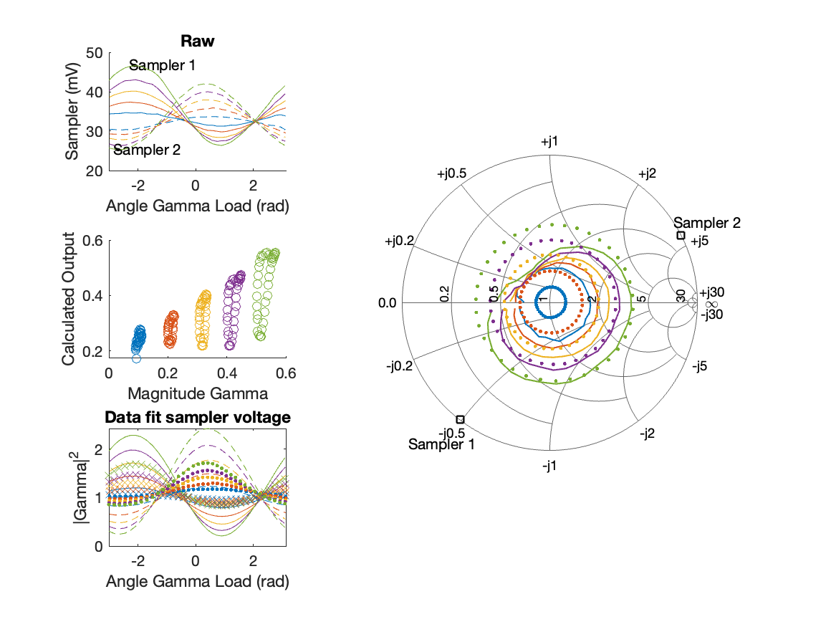
Sampler Performance x^3 Frequency 11.40 GHz, Power 14 dBm
Sampler Av
Sampler 1: 6.811078e-08
Sampler 2: 0.000
Sampler Av3
Sampler 1: 17.339
Sampler 2: 19.563
Sampler Offset (rather than -1)
-0.38013
Goodness Of fit
0.72014

Slide 21
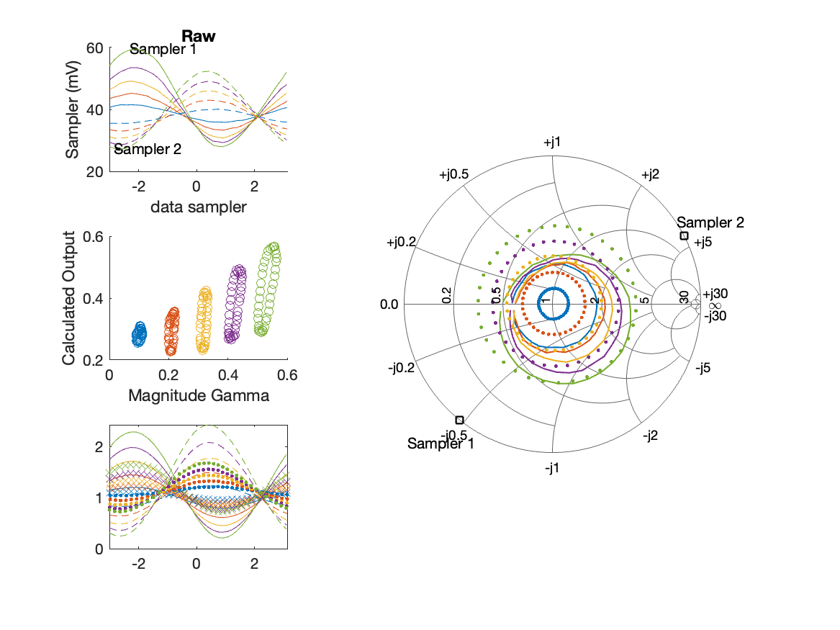
Sampler Performance Frequency 11.40 GHz, Power 16 dBm
Sampler Av
Sampler 1: 14.660
Sampler 2: 18.935
Sampler Offset (rather than -1)
-1.201
Goodness Of fit
0.96264

Slide 22
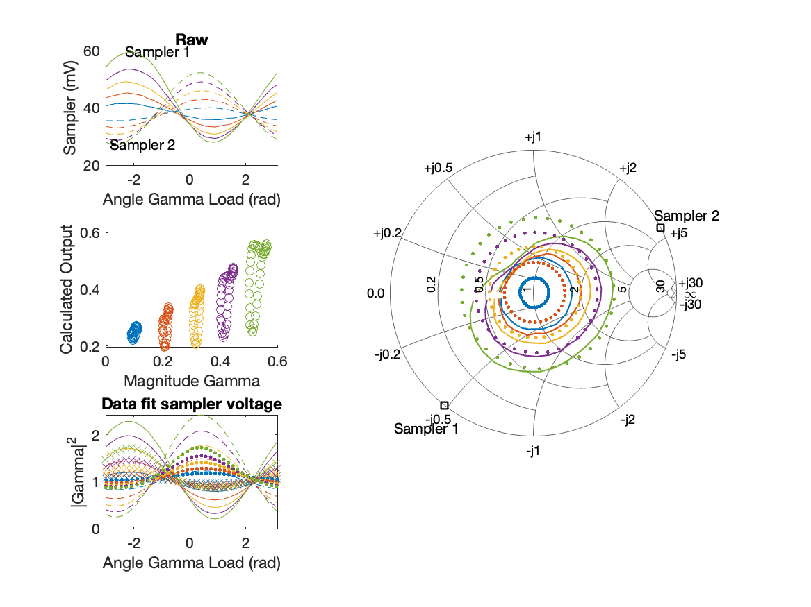
Sampler Performance x^3 Frequency 11.40 GHz, Power 16 dBm
Sampler Av
Sampler 1: 3.124893e-06
Sampler 2: 0.000
Sampler Av3
Sampler 1: 13.138
Sampler 2: 15.175
Sampler Offset (rather than -1)
-0.25794
Goodness Of fit
0.6878

Slide 23

Sampler Performance Frequency 11.40 GHz, Power 18 dBm
Sampler Av
Sampler 1: 9.628
Sampler 2: 12.871
Sampler Offset (rather than -1)
-0.93965
Goodness Of fit
1.072

Slide 24
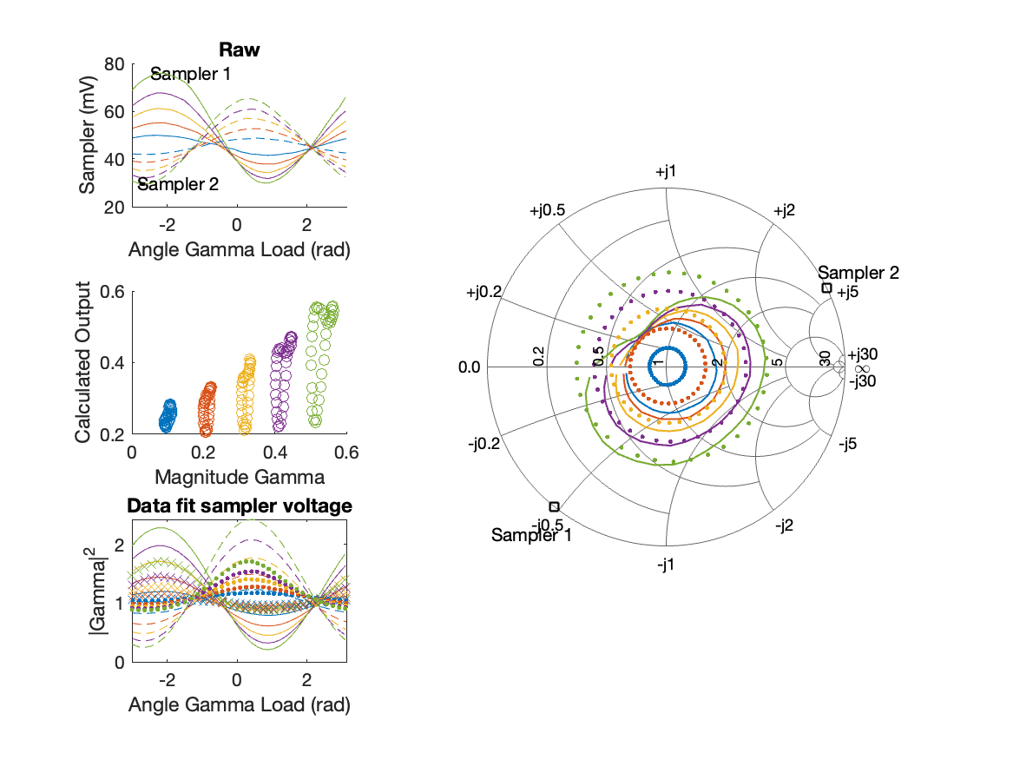
Sampler Performance x^3 Frequency 11.40 GHz, Power 18 dBm
Sampler Av
Sampler 1: 4.851389e-08
Sampler 2: 0.000
Sampler Av3
Sampler 1: 10.028
Sampler 2: 11.813
Sampler Offset (rather than -1)
-0.18939
Goodness Of fit
0.72814

Slide 25
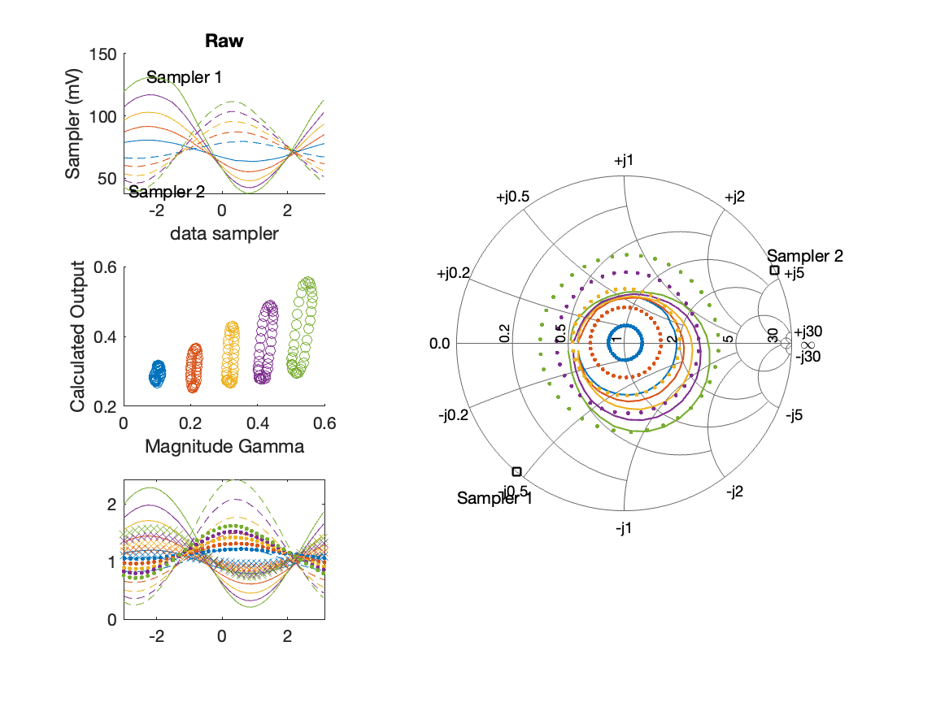
Sampler Performance Frequency 11.40 GHz, Power 22 dBm
Sampler Av
Sampler 1: 4.497
Sampler 2: 6.284
Sampler Offset (rather than -1)
-0.69352
Goodness Of fit
1.1124

Slide 26

Sampler Performance x^3 Frequency 11.40 GHz, Power 22 dBm
Sampler Av
Sampler 1: 2.548418e-09
Sampler 2: 0.000
Sampler Av3
Sampler 1: 5.586
Sampler 2: 6.710
Sampler Offset (rather than -1)
-0.12279
Goodness Of fit
0.69469

Slide 27
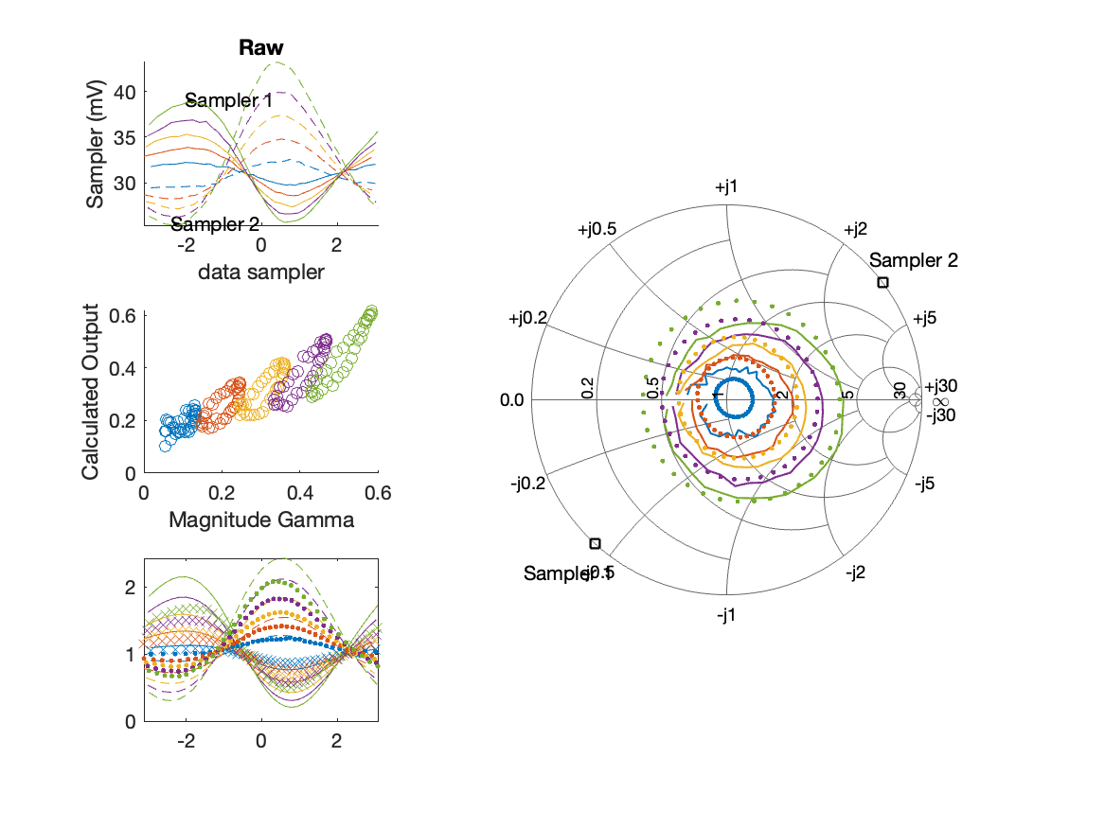
Sampler Performance Frequency 11.90 GHz, Power 14 dBm
Sampler Av
Sampler 1: 45.091
Sampler 2: 39.425
Sampler Offset (rather than -1)
-2.5822
Goodness Of fit
0.33135

Slide 28
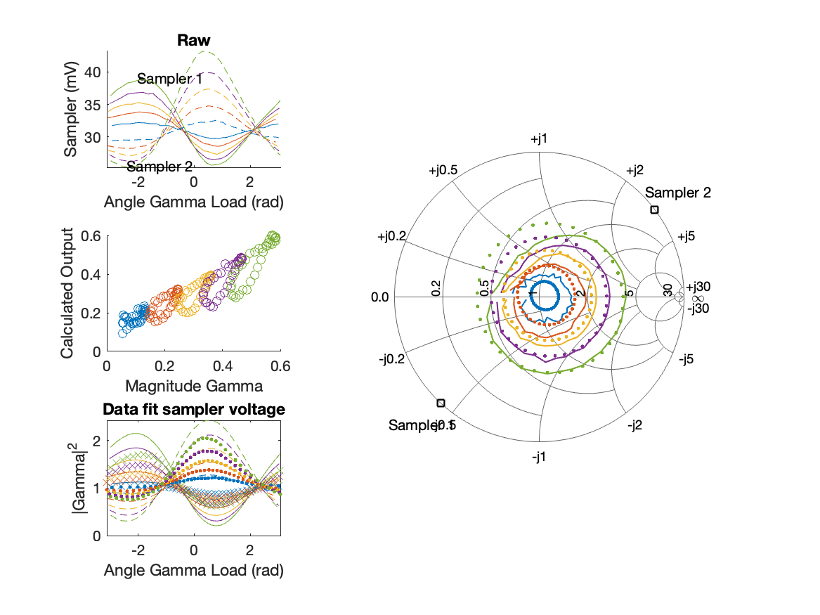
Sampler Performance x^3 Frequency 11.90 GHz, Power 14 dBm
Sampler Av
Sampler 1: 6.456632e-04
Sampler 2: 23.222
Sampler Av3
Sampler 1: 23.463
Sampler 2: 15.303
Sampler Offset (rather than -1)
-1.1801
Goodness Of fit
0.25405

Slide 29
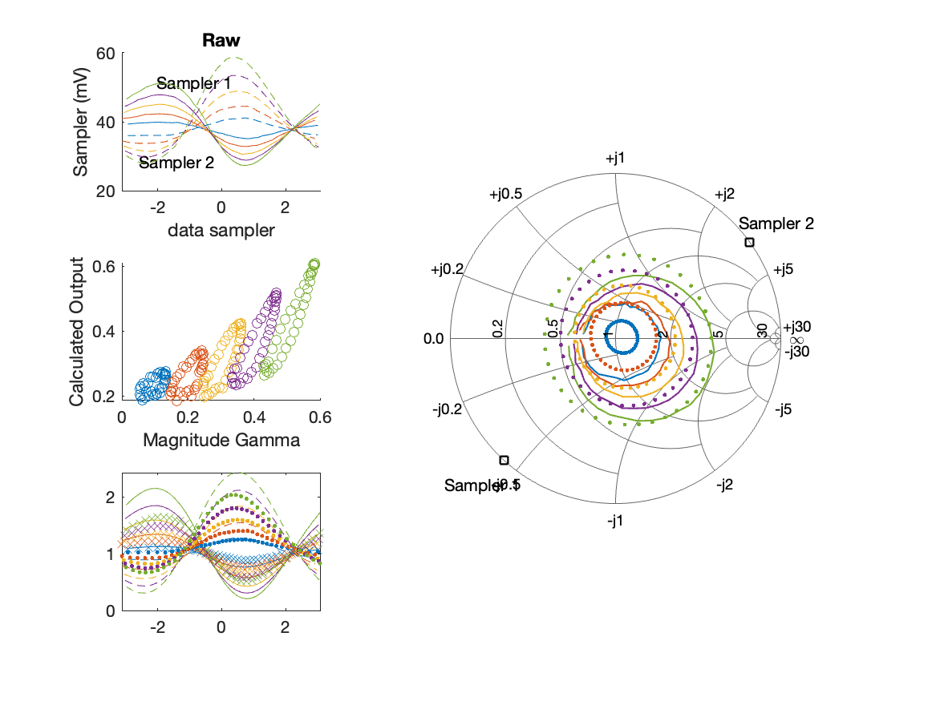
Sampler Performance Frequency 11.90 GHz, Power 16 dBm
Sampler Av
Sampler 1: 23.642
Sampler 2: 22.235
Sampler Offset (rather than -1)
-1.6879
Goodness Of fit
0.47486

Slide 30
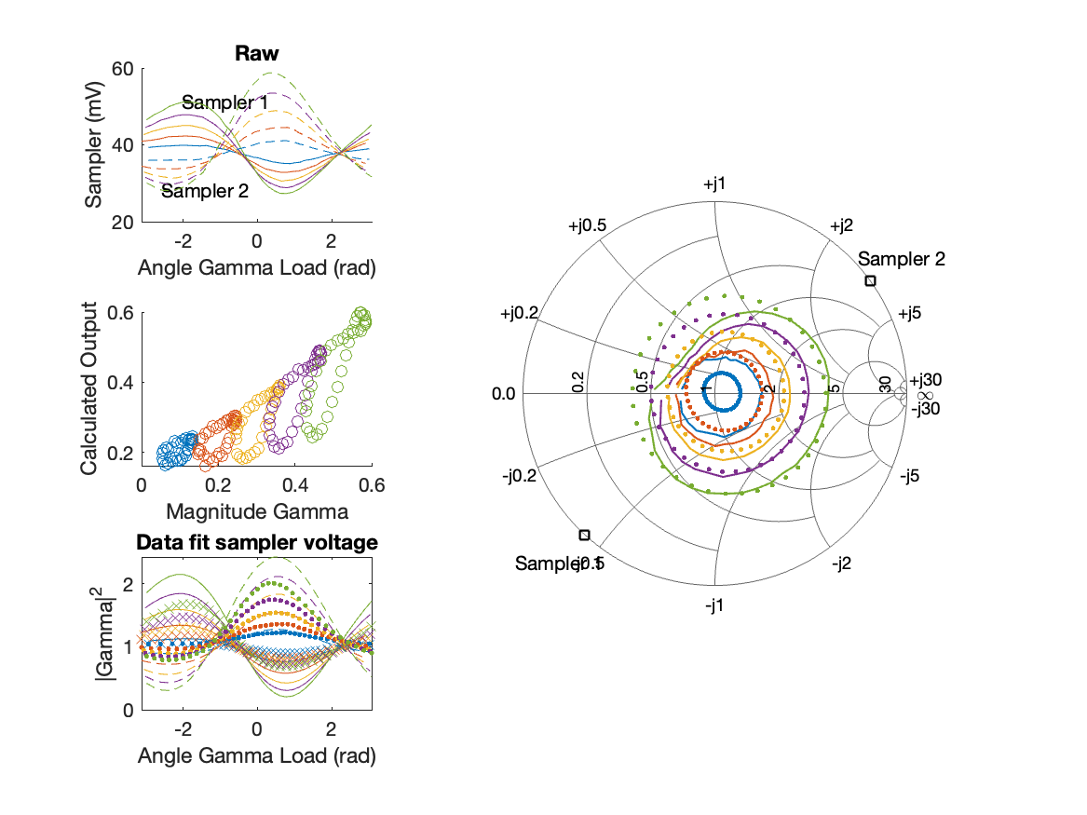
Sampler Performance x^3 Frequency 11.90 GHz, Power 16 dBm
Sampler Av
Sampler 1: 3.210818e-07
Sampler 2: 11.714
Sampler Av3
Sampler 1: 16.354
Sampler 2: 11.151
Sampler Offset (rather than -1)
-0.71895
Goodness Of fit
0.33157

Slide 31
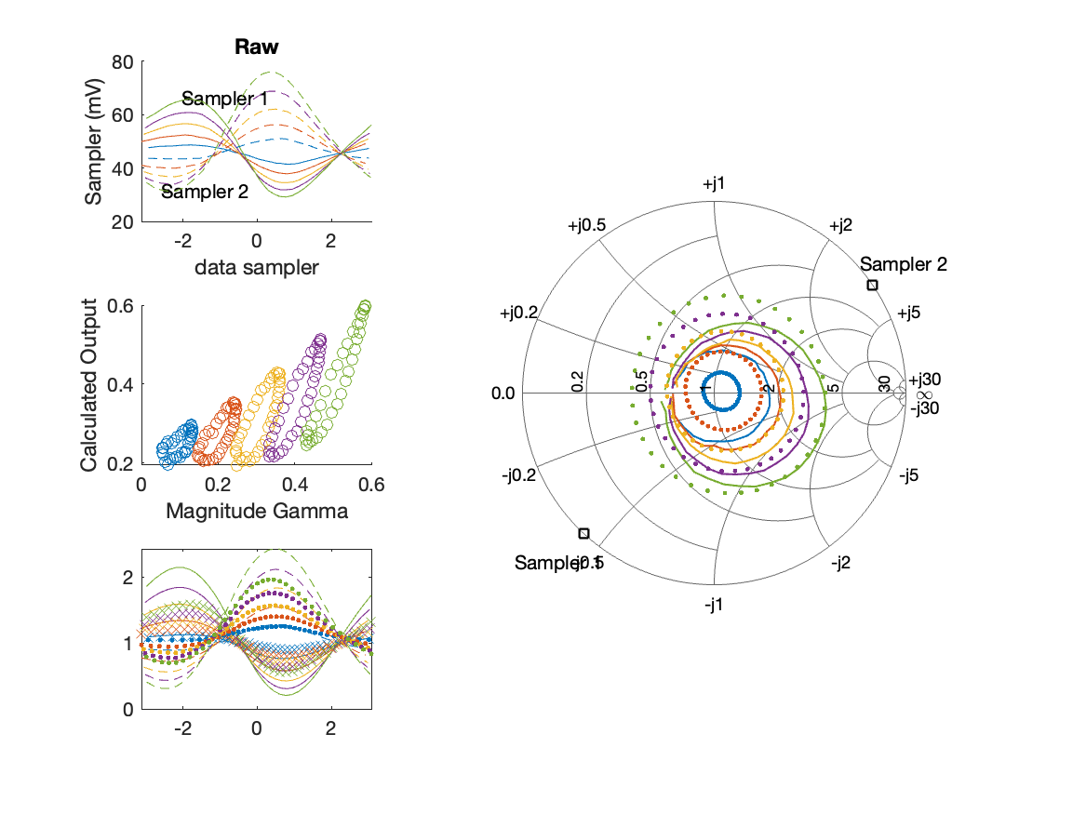
Sampler Performance Frequency 11.90 GHz, Power 18 dBm
Sampler Av
Sampler 1: 14.076
Sampler 2: 14.119
Sampler Offset (rather than -1)
-1.2357
Goodness Of fit
0.60595

Slide 32
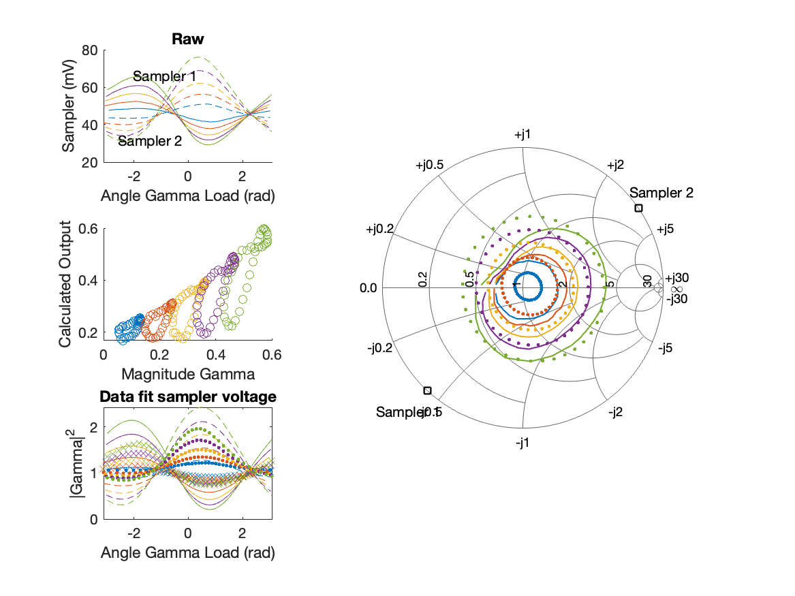
Sampler Performance x^3 Frequency 11.90 GHz, Power 18 dBm
Sampler Av
Sampler 1: 5.759242e-07
Sampler 2: 5.737
Sampler Av3
Sampler 1: 11.969
Sampler 2: 9.040
Sampler Offset (rather than -1)
-0.45832
Goodness Of fit
0.40017

Slide 33

Sampler Performance Frequency 11.90 GHz, Power 22 dBm
Sampler Av
Sampler 1: 6.174
Sampler 2: 6.713
Sampler Offset (rather than -1)
-0.89196
Goodness Of fit
0.72187

Slide 34

Sampler Performance x^3 Frequency 11.90 GHz, Power 22 dBm
Sampler Av
Sampler 1: 3.987674e-12
Sampler 2: 2.750
Sampler Av3
Sampler 1: 6.571
Sampler 2: 4.961
Sampler Offset (rather than -1)
-0.32616
Goodness Of fit
0.44641

Slide 35
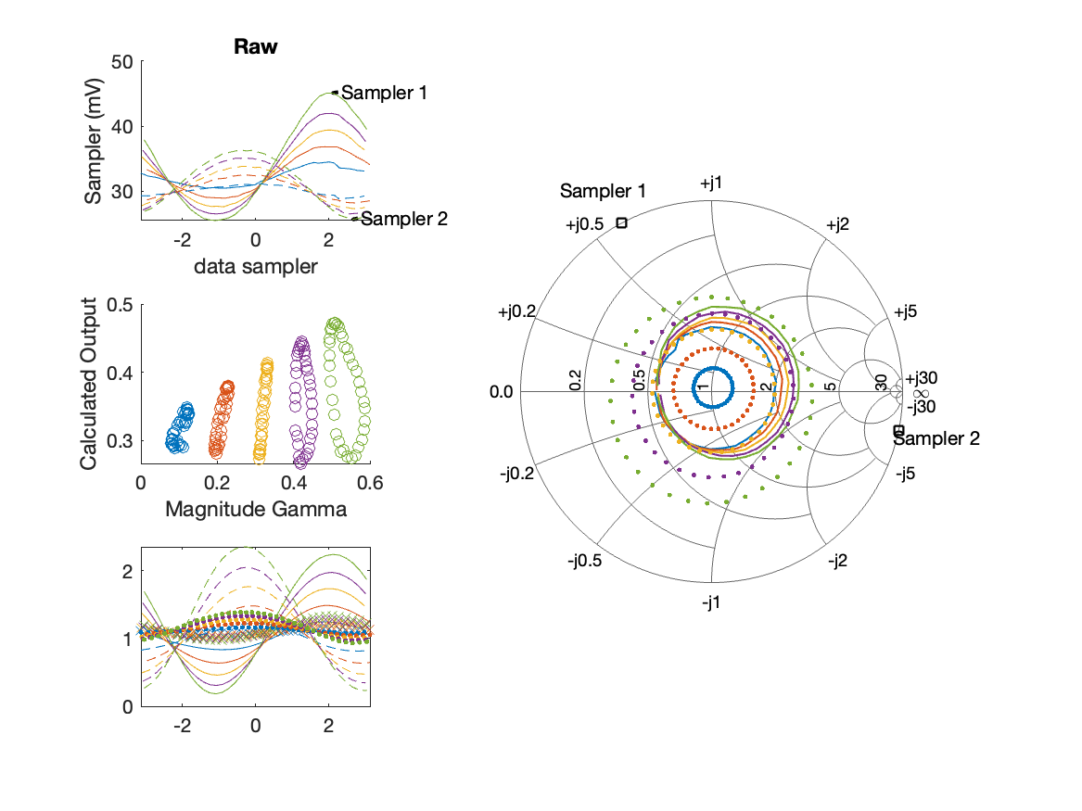
Sampler Performance Frequency 8.90 GHz, Power 14 dBm
Sampler Av
Sampler 1: 8.883
Sampler 2: 21.307
Sampler Offset (rather than -1)
-0.82764
Goodness Of fit
1.518

Slide 36
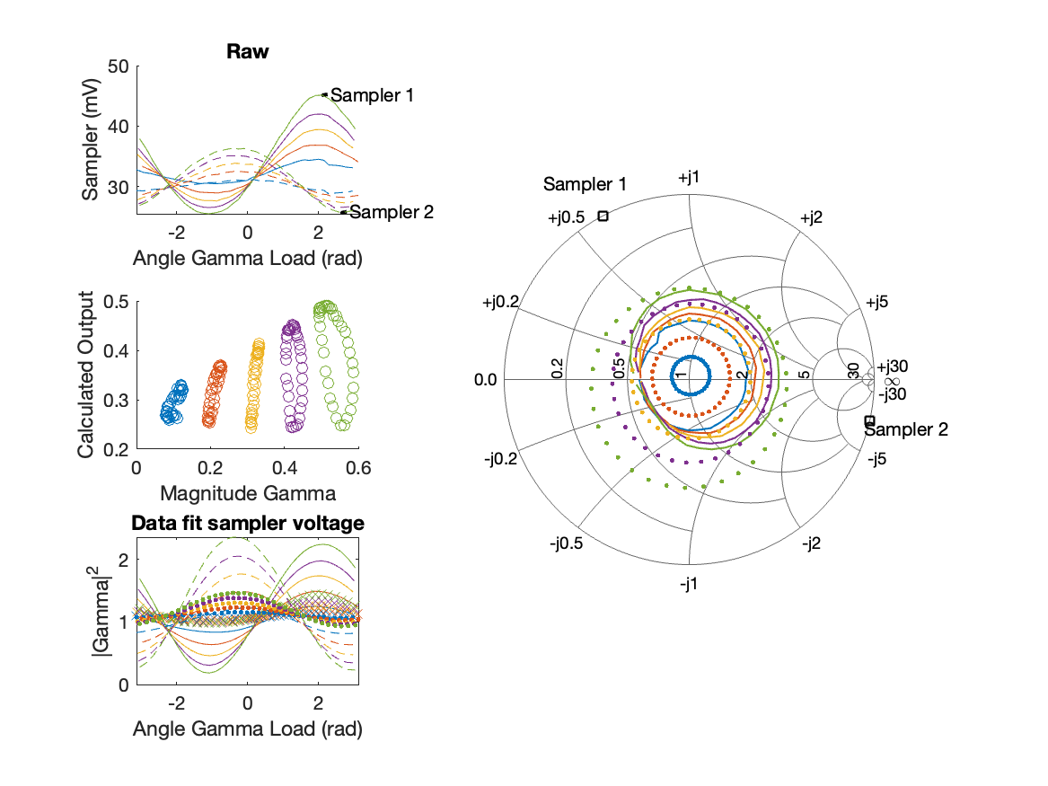
Sampler Performance x^3 Frequency 8.90 GHz, Power 14 dBm
Sampler Av
Sampler 1: 3.450209e-14
Sampler 2: 0.000
Sampler Av3
Sampler 1: 14.571
Sampler 2: 20.479
Sampler Offset (rather than -1)
-0.25272
Goodness Of fit
1.3218

Slide 37
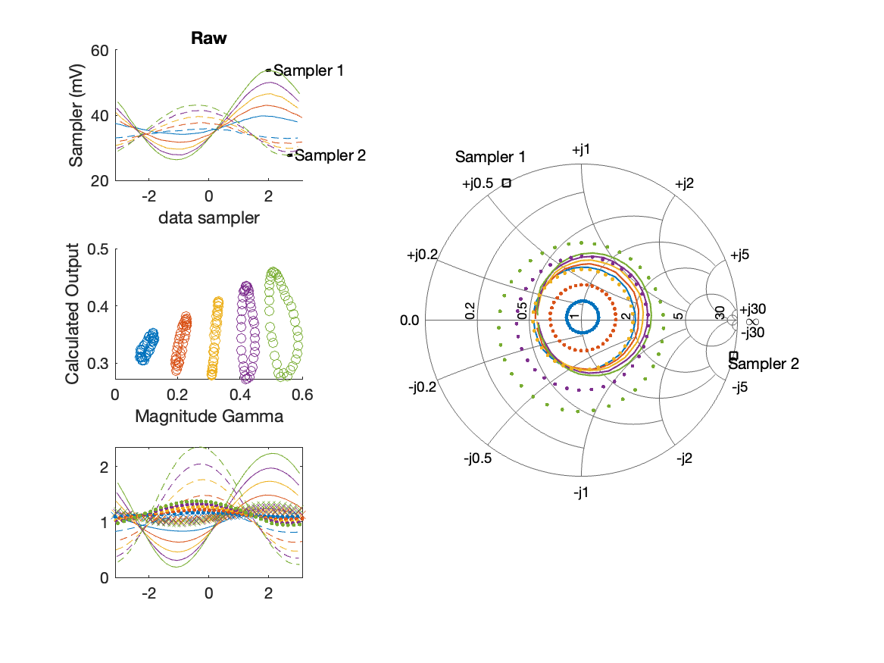
Sampler Performance Frequency 8.90 GHz, Power 16 dBm
Sampler Av
Sampler 1: 6.017
Sampler 2: 13.926
Sampler Offset (rather than -1)
-0.59187
Goodness Of fit
1.5775

Slide 38
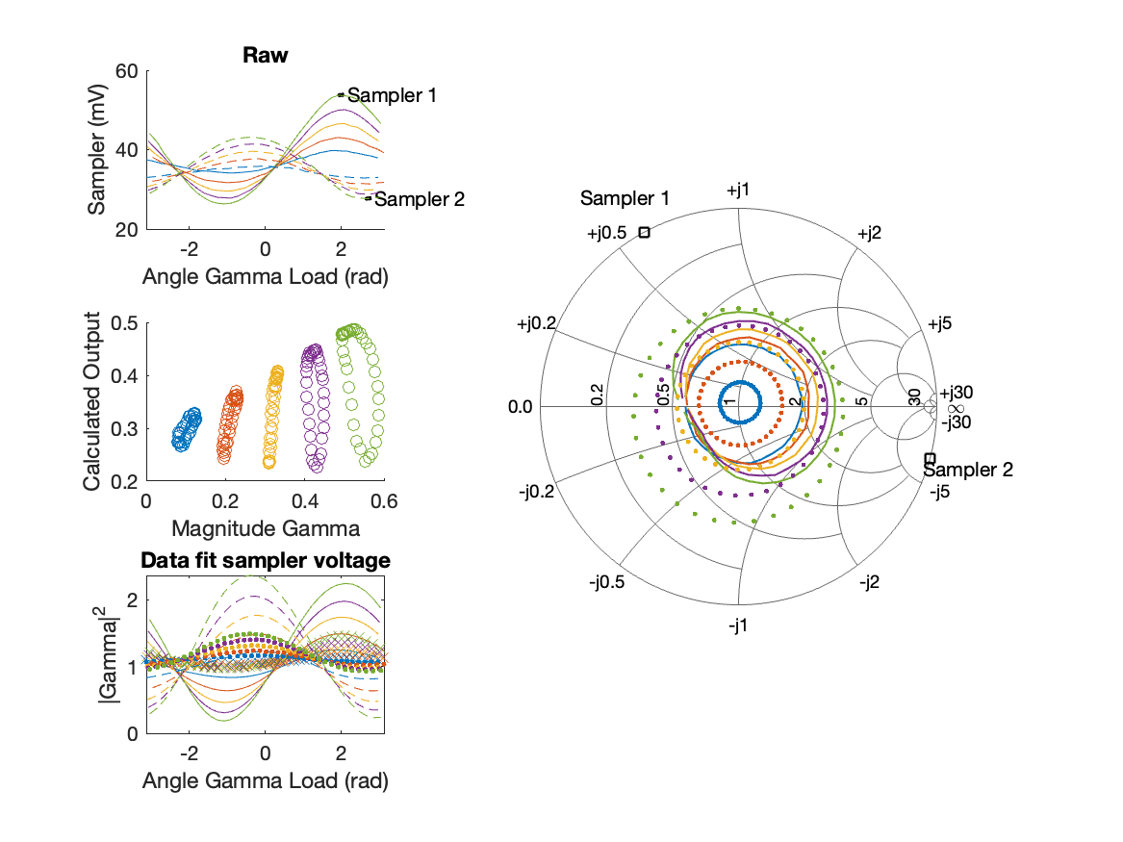
Sampler Performance x^3 Frequency 8.90 GHz, Power 16 dBm
Sampler Av
Sampler 1: 1.945892e-10
Sampler 2: 0.000
Sampler Av3
Sampler 1: 12.180
Sampler 2: 16.768
Sampler Offset (rather than -1)
-0.19305
Goodness Of fit
1.3127

Slide 39
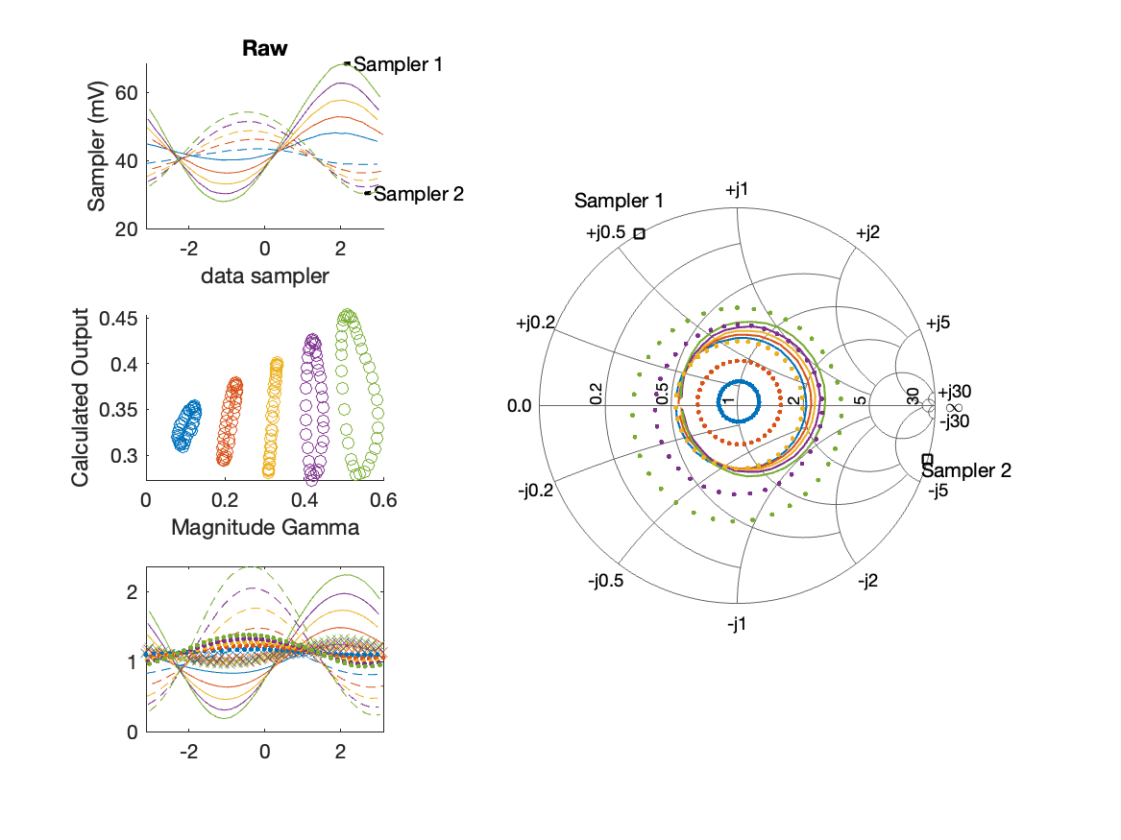
Sampler Performance Frequency 8.90 GHz, Power 18 dBm
Sampler Av
Sampler 1: 4.340
Sampler 2: 9.366
Sampler Offset (rather than -1)
-0.46503
Goodness Of fit
1.6046

Slide 40
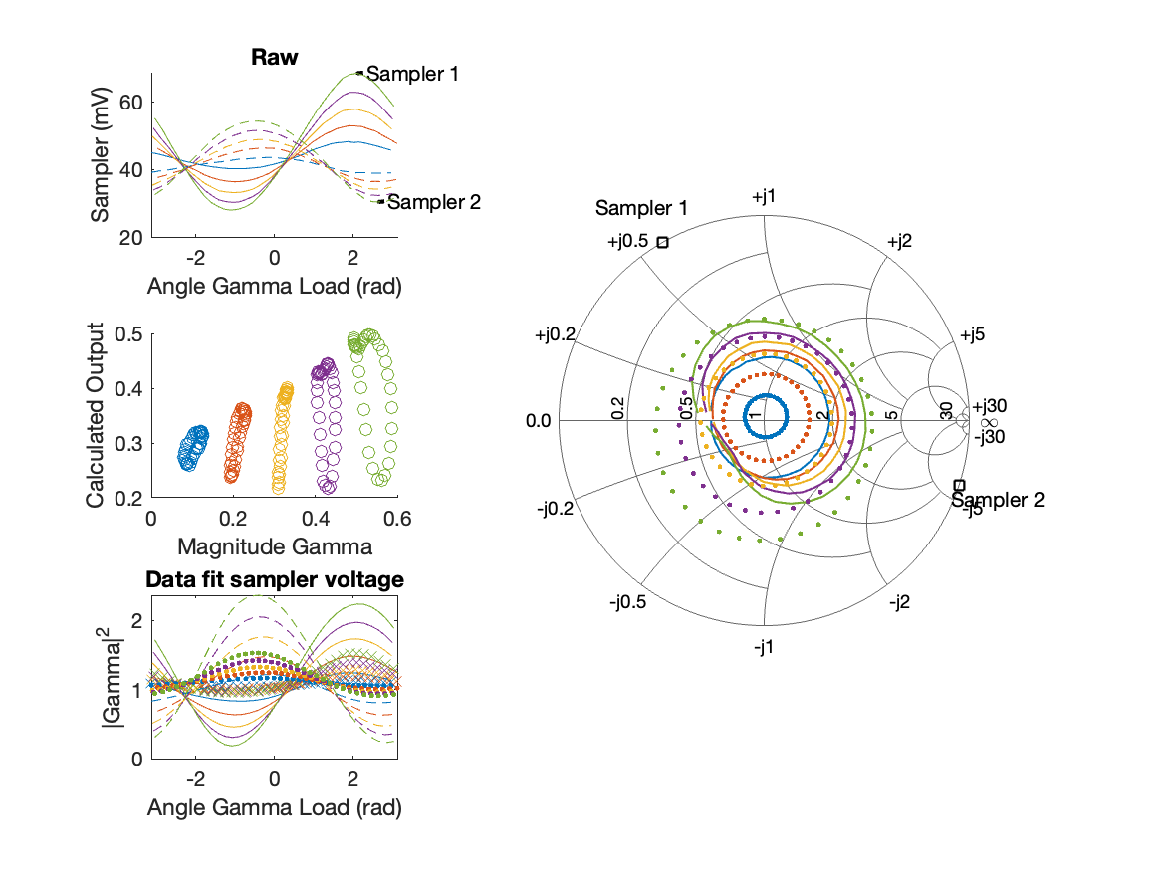
Sampler Performance x^3 Frequency 8.90 GHz, Power 18 dBm
Sampler Av
Sampler 1: 2.927247e-10
Sampler 2: 0.000
Sampler Av3
Sampler 1: 9.842
Sampler 2: 13.280
Sampler Offset (rather than -1)
-0.15883
Goodness Of fit
1.2535

Slide 41
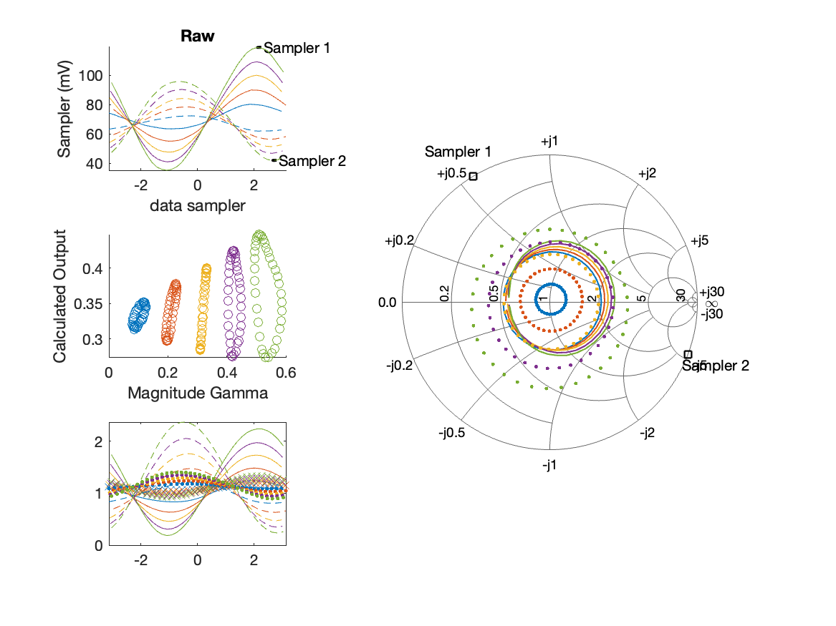
Sampler Performance Frequency 8.90 GHz, Power 22 dBm
Sampler Av
Sampler 1: 2.403
Sampler 2: 4.711
Sampler Offset (rather than -1)
-0.37643
Goodness Of fit
1.6197

Slide 42
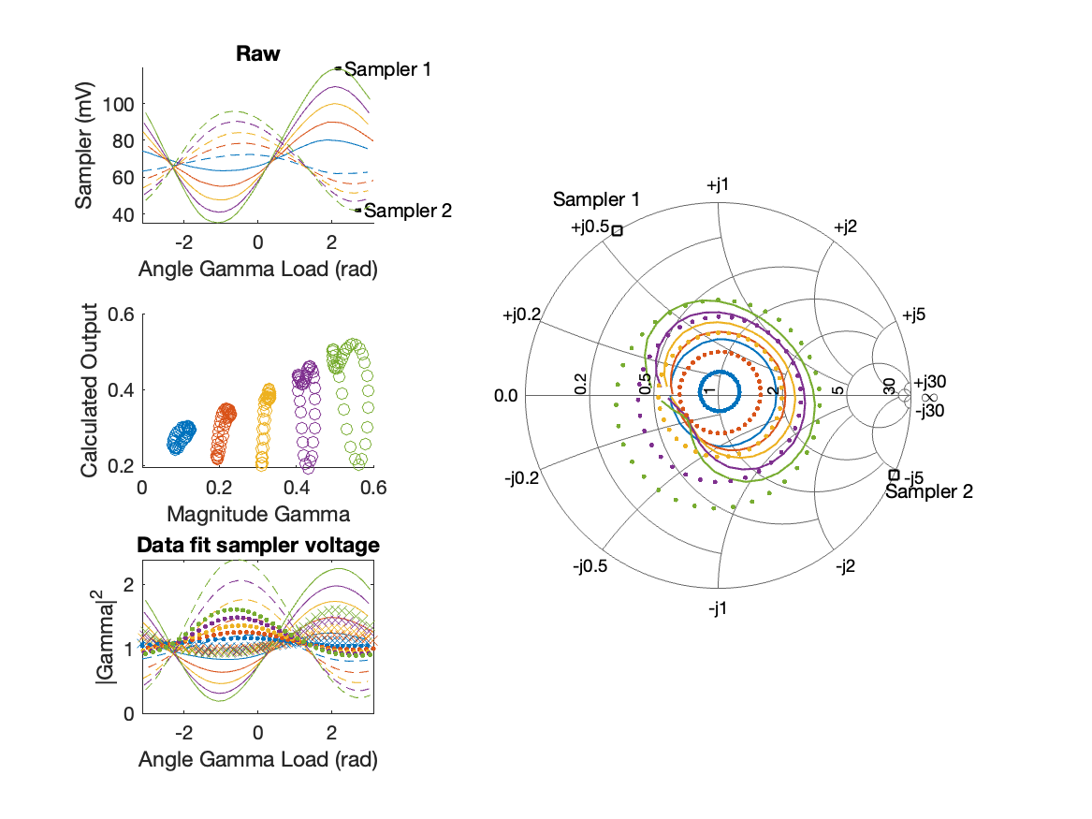
Sampler Performance x^3 Frequency 8.90 GHz, Power 22 dBm
Sampler Av
Sampler 1: 2.220447e-14
Sampler 2: 0.000
Sampler Av3
Sampler 1: 5.865
Sampler 2: 7.632
Sampler Offset (rather than -1)
-0.13356
Goodness Of fit
1.1183

Slide 43
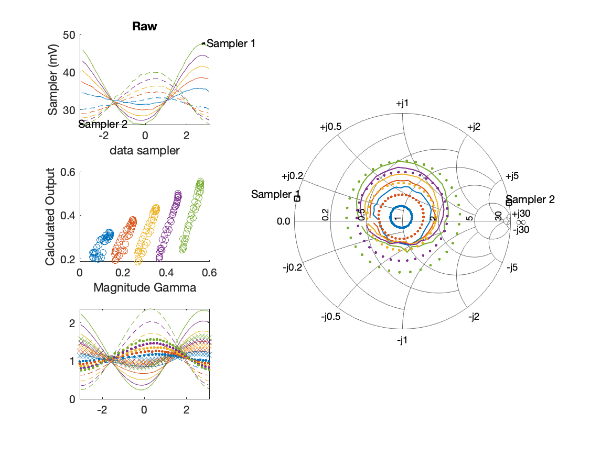
Sampler Performance Frequency 9.40 GHz, Power 14 dBm
Sampler Av
Sampler 1: 19.081
Sampler 2: 29.429
Sampler Offset (rather than -1)
-1.5003
Goodness Of fit
0.81882

Slide 44
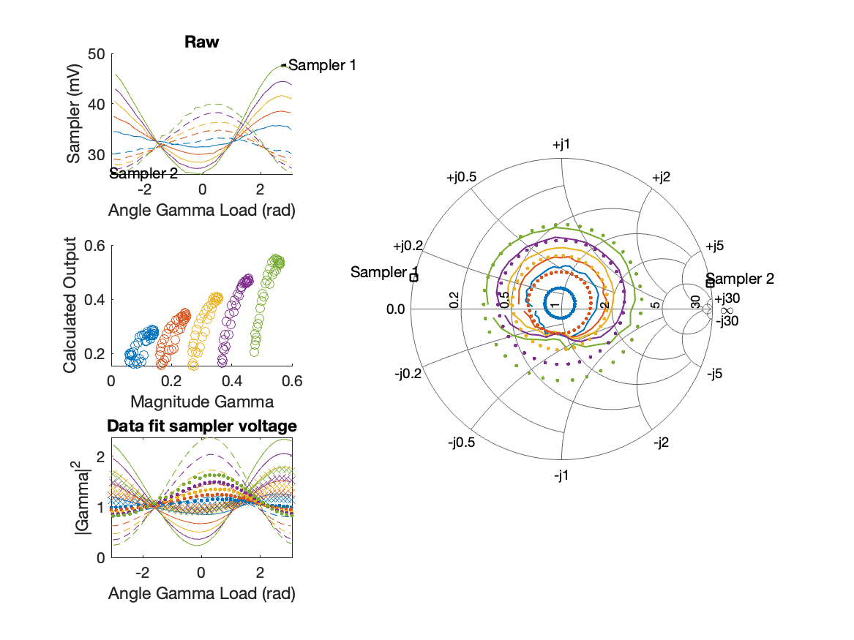
Sampler Performance x^3 Frequency 9.40 GHz, Power 14 dBm
Sampler Av
Sampler 1: 5.521968e-11
Sampler 2: 0.000
Sampler Av3
Sampler 1: 16.798
Sampler 2: 20.649
Sampler Offset (rather than -1)
-0.40459
Goodness Of fit
0.56606

Slide 45
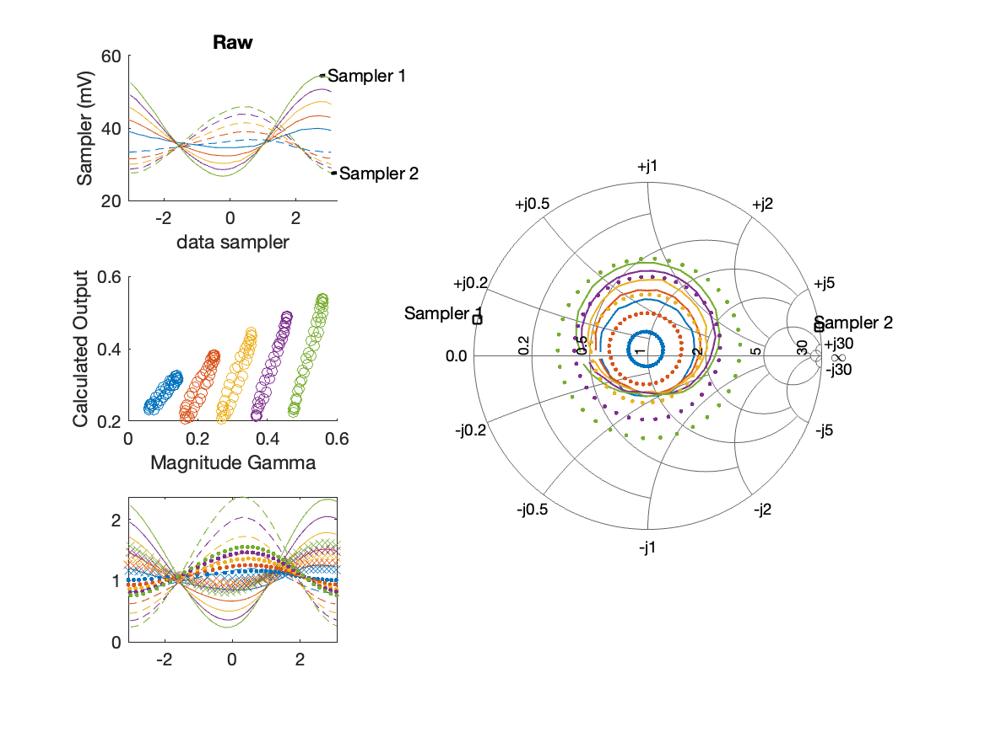
Sampler Performance Frequency 9.40 GHz, Power 16 dBm
Sampler Av
Sampler 1: 14.431
Sampler 2: 21.648
Sampler Offset (rather than -1)
-1.2153
Goodness Of fit
0.92809

Slide 46
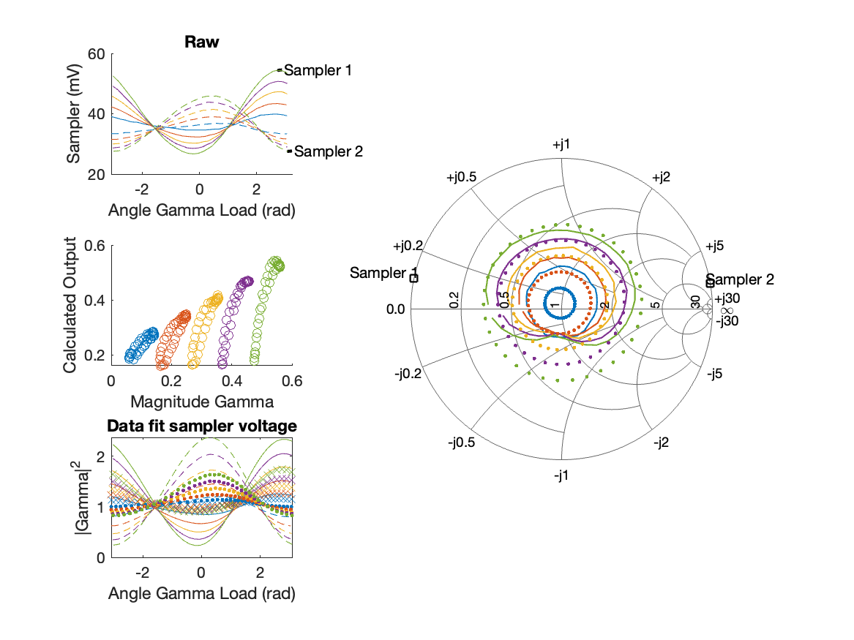
Sampler Performance x^3 Frequency 9.40 GHz, Power 16 dBm
Sampler Av
Sampler 1: 8.056586e-10
Sampler 2: 0.000
Sampler Av3
Sampler 1: 14.373
Sampler 2: 17.470
Sampler Offset (rather than -1)
-0.32506
Goodness Of fit
0.60734

Slide 47
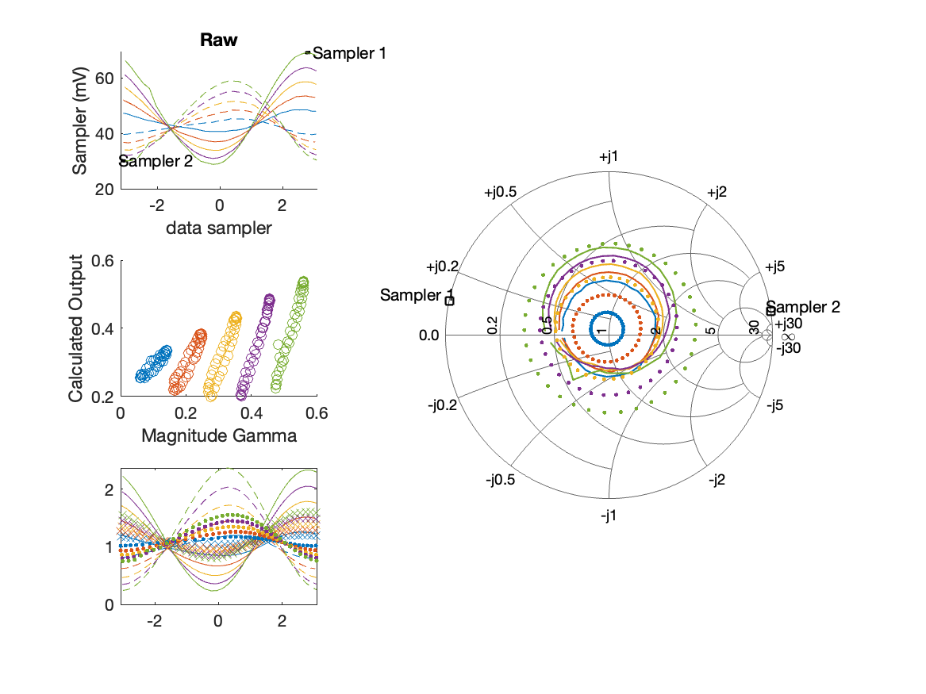
Sampler Performance Frequency 9.40 GHz, Power 18 dBm
Sampler Av
Sampler 1: 9.895
Sampler 2: 13.874
Sampler Offset (rather than -1)
-0.94222
Goodness Of fit
0.97367

Slide 48
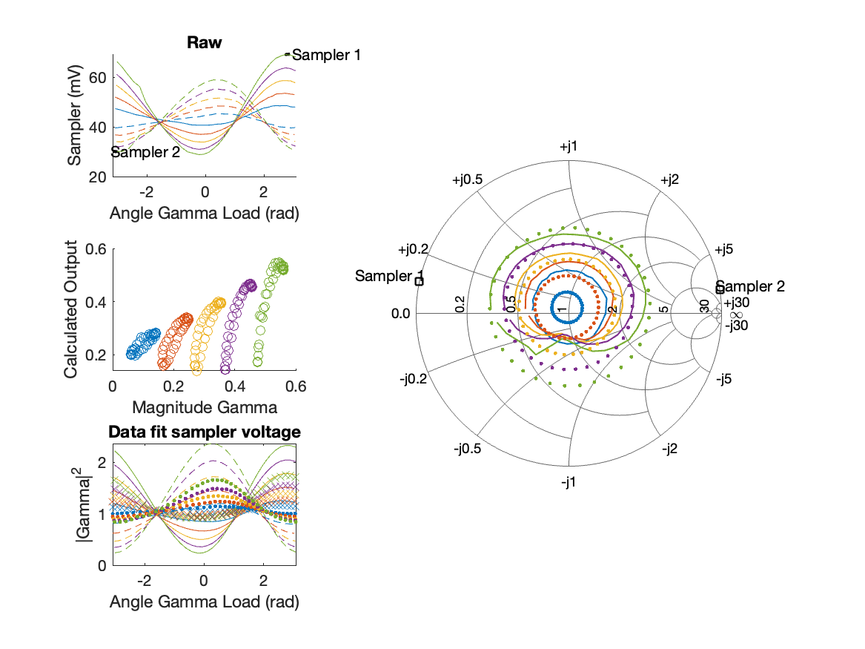
Sampler Performance x^3 Frequency 9.40 GHz, Power 18 dBm
Sampler Av
Sampler 1: 2.306563e-14
Sampler 2: 0.000
Sampler Av3
Sampler 1: 11.132
Sampler 2: 13.195
Sampler Offset (rather than -1)
-0.23888
Goodness Of fit
0.57837

Slide 49
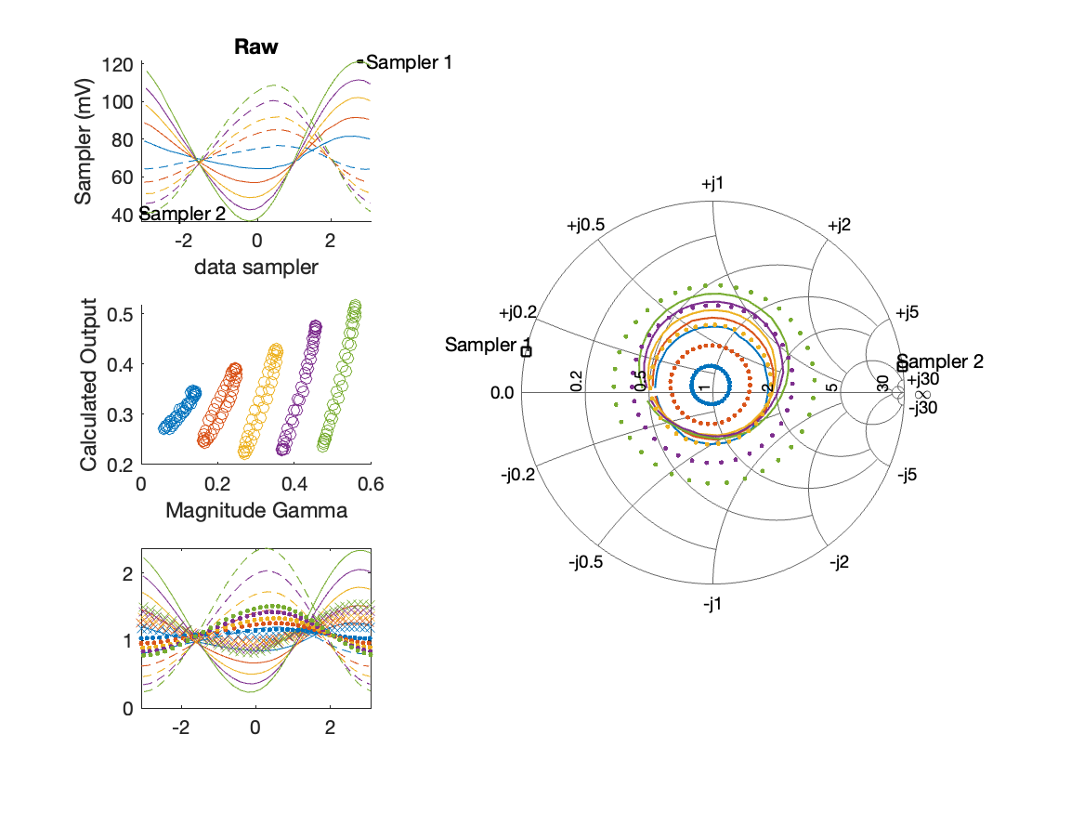
Sampler Performance Frequency 9.40 GHz, Power 22 dBm
Sampler Av
Sampler 1: 4.246
Sampler 2: 5.359
Sampler Offset (rather than -1)
-0.59193
Goodness Of fit
1.1227

Slide 50
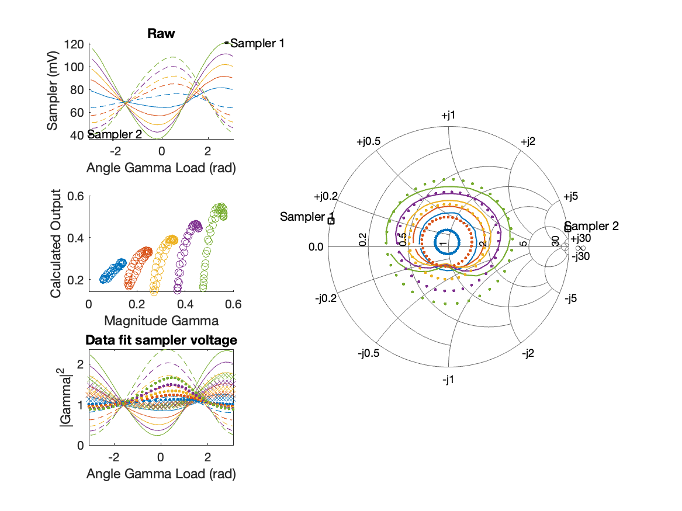
Sampler Performance x^3 Frequency 9.40 GHz, Power 22 dBm
Sampler Av
Sampler 1: 2.676451e-14
Sampler 2: 0.000
Sampler Av3
Sampler 1: 6.101
Sampler 2: 6.854
Sampler Offset (rather than -1)
-0.14252
Goodness Of fit
0.60853

Slide 51
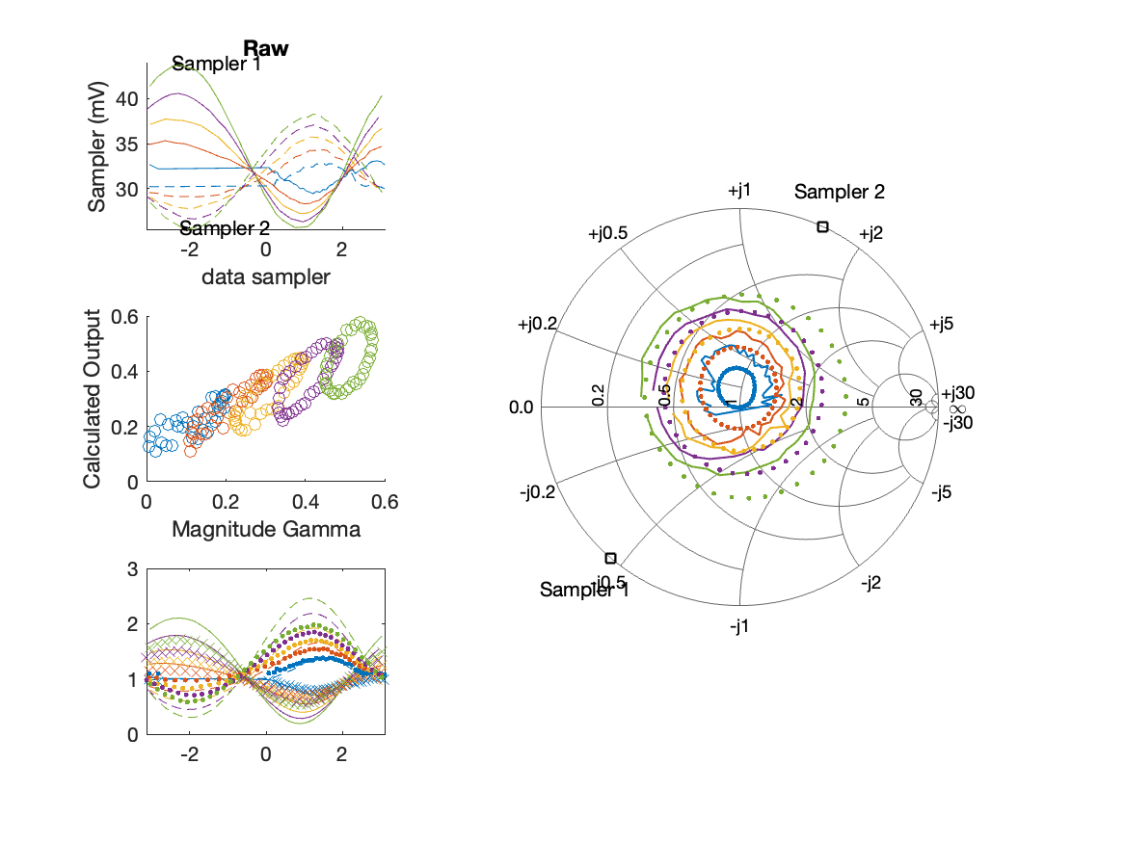
Sampler Performance Frequency 9.90 GHz, Power 14 dBm
Sampler Av
Sampler 1: 32.573
Sampler 2: 54.781
Sampler Offset (rather than -1)
-2.687
Goodness Of fit
0.5466

Slide 52
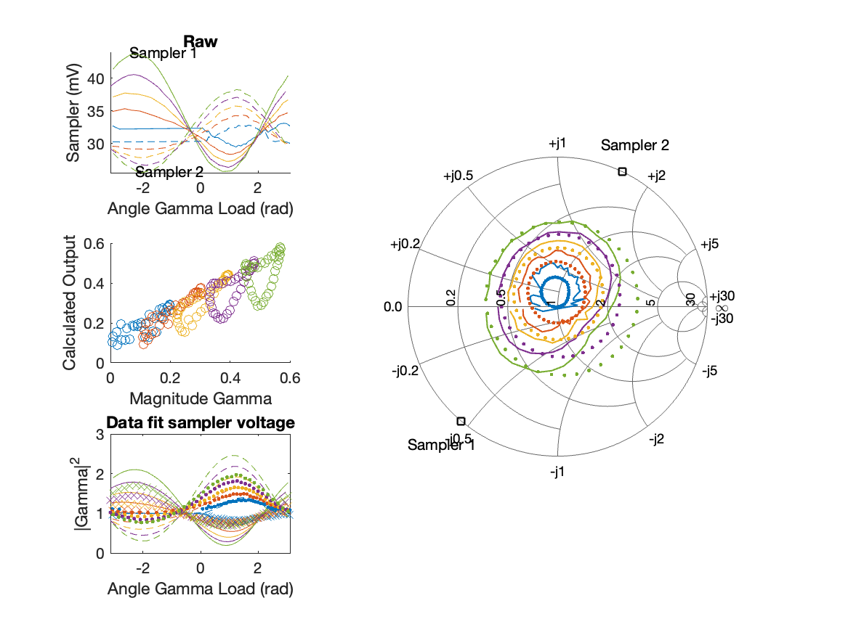
Sampler Performance x^3 Frequency 9.90 GHz, Power 14 dBm
Sampler Av
Sampler 1: 2.503456e-01
Sampler 2: 0.000
Sampler Av3
Sampler 1: 19.647
Sampler 2: 24.788
Sampler Offset (rather than -1)
-0.67035
Goodness Of fit
0.39304

Slide 53
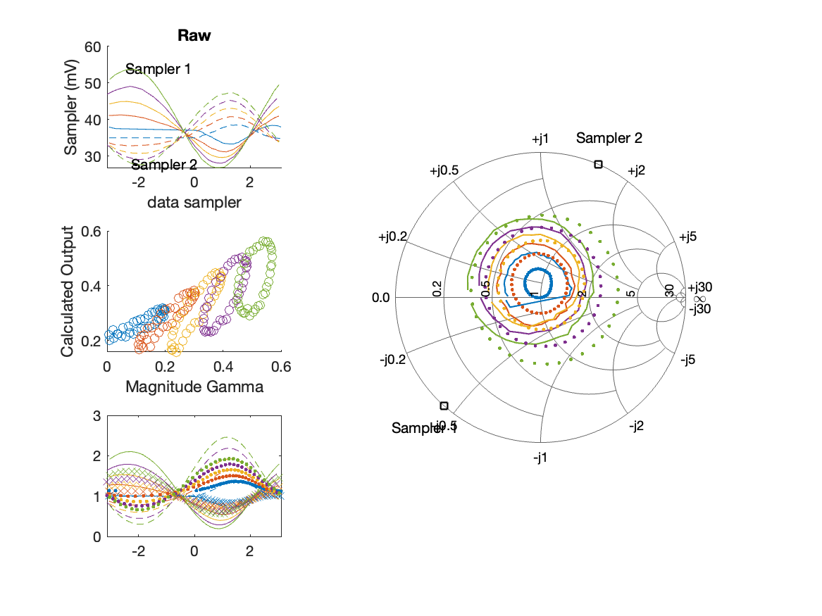
Sampler Performance Frequency 9.90 GHz, Power 16 dBm
Sampler Av
Sampler 1: 19.524
Sampler 2: 32.038
Sampler Offset (rather than -1)
-1.8037
Goodness Of fit
0.67332

Slide 54
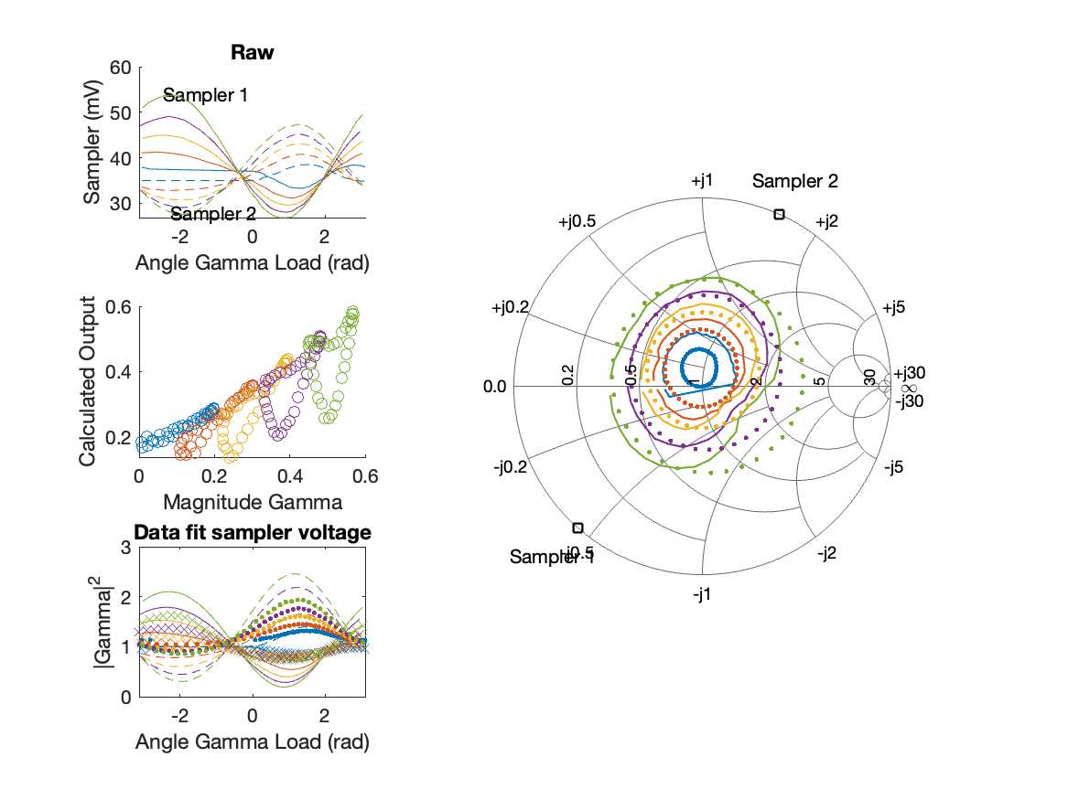
Sampler Performance x^3 Frequency 9.90 GHz, Power 16 dBm
Sampler Av
Sampler 1: 1.297947e-05
Sampler 2: 0.000
Sampler Av3
Sampler 1: 14.875
Sampler 2: 18.530
Sampler Offset (rather than -1)
-0.41175
Goodness Of fit
0.45672

Slide 55
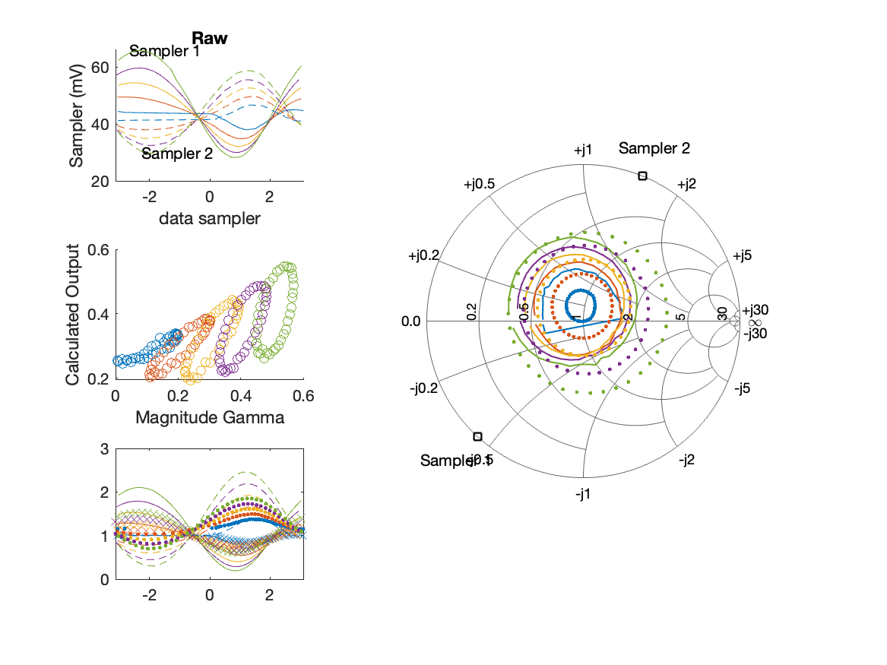
Sampler Performance Frequency 9.90 GHz, Power 18 dBm
Sampler Av
Sampler 1: 12.292
Sampler 2: 19.890
Sampler Offset (rather than -1)
-1.2983
Goodness Of fit
0.87004

Slide 56
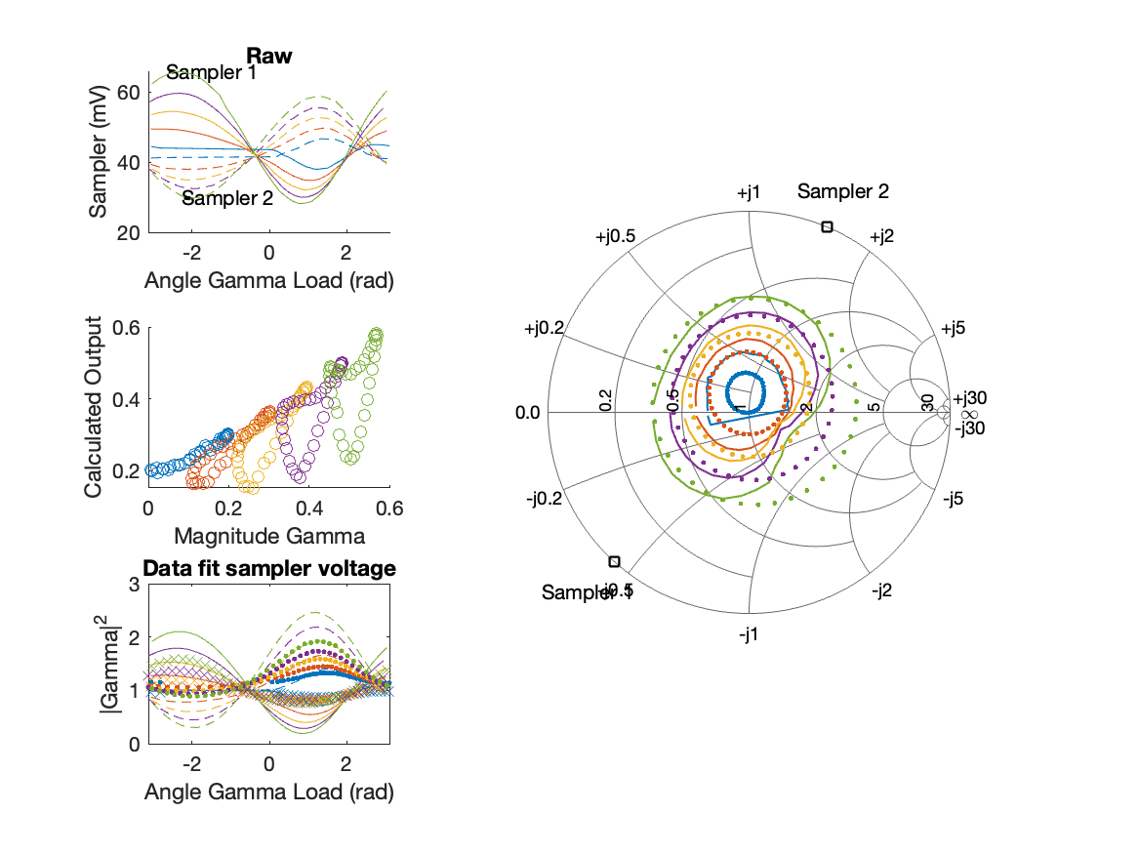
Sampler Performance x^3 Frequency 9.90 GHz, Power 18 dBm
Sampler Av
Sampler 1: 5.264814e-12
Sampler 2: 0.000
Sampler Av3
Sampler 1: 11.625
Sampler 2: 14.265
Sampler Offset (rather than -1)
-0.2982
Goodness Of fit
0.54404

Slide 57
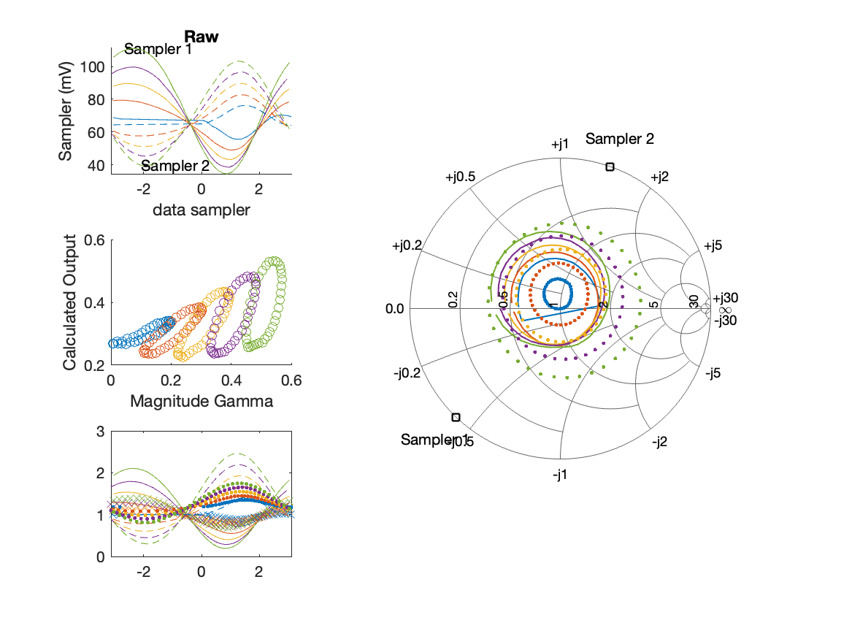
Sampler Performance Frequency 9.90 GHz, Power 22 dBm
Sampler Av
Sampler 1: 4.549
Sampler 2: 7.337
Sampler Offset (rather than -1)
-0.70987
Goodness Of fit
1.0012

Slide 58

Sampler Performance x^3 Frequency 9.90 GHz, Power 22 dBm
Sampler Av
Sampler 1: 2.449693e-14
Sampler 2: 0.000
Sampler Av3
Sampler 1: 6.297
Sampler 2: 7.539
Sampler Offset (rather than -1)
-0.14982
Goodness Of fit
0.59378

